Slide 1
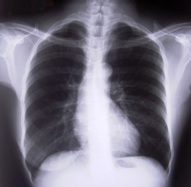
Respiratory System Physiology
Chapter 13

Slide 2
Respiratory Physiology
Pulmonary ventilation
Air movement in/out of alveoli
External respiration
Gas exchange btw pulmonary blood and alveoli
Respiratory gas transport
Oxygen and carbon dioxide moving to/from lungs/body
Internal respiration
Gas exchange btw blood and cells

Slide 3
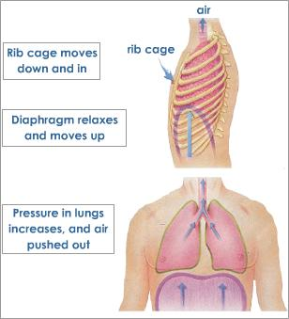
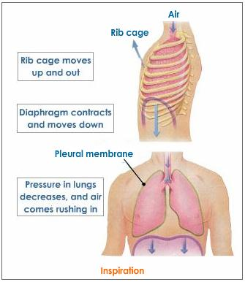
Mechanics
Volume changes lead to pressure changes, which lead to the flow of gases to equalize the pressure.
2 phases
Inspiration – air flows into the lungs
Expiration – air flows out of the lungs

Slide 4
Inspiration (inhalation)
Diaphragm contracts (flattens)
Causes height of cavity to increase
External intercostal muscles/ Obliques
contract – lift the rib cage and move
sternum forward
Causes lungs to stretch
Intrapulmonary volume increases – intrapulmonary pressure (w/in lungs) decreases - gases spread to fill space
Forms a partial vacuum that sucks in air
Vacuum continues until intrapulmonary pressure is = to atmospheric pressure

Slide 5
Expiration (exhalation)
Generally passive
Relaxation of muscles causes intrapulmonary volume to decrease
Internal intercostals/latissimus dorsi counteract
This causes intrapulmonary pressure to increase
Gases move out until pressures equalize
Forced expiration (active process)
Occurs when passageways are narrowed
or clogged
Ex. Asthma, bronchitis, pneumonia
Intrapleural pressure – pressure w/in
the pleural space – should always be
lower than atmospheric press. – prevents
lung collapse

Slide 6
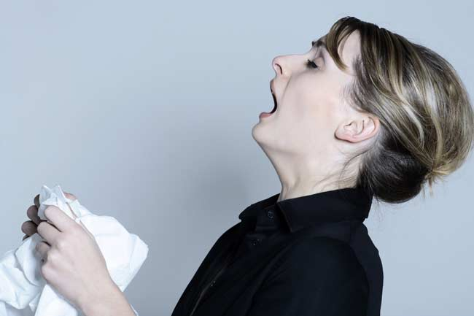
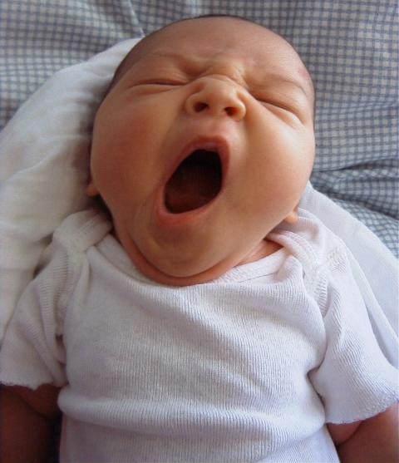
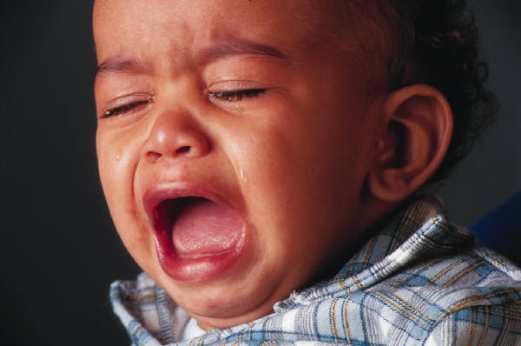
Nonrespiratory air movements
Movement of air for reasons other than breathing
Cough, sneeze, crying, laughing, hiccups, yawn

Slide 7
Volume
Tidal volume (TV)– normal respiratory volume
Moves about 500ml of air each breath
Inspiratory reserve volume (IRV)
Amount that can be forcibly inhaled over TV
2100-2300ml
Expiratory reserve volume (ERV)
Amount that can be forcibly exhaled over TV
1200ml
Residual volume – air left in lungs
Helps keep alveoli inflated

Slide 8
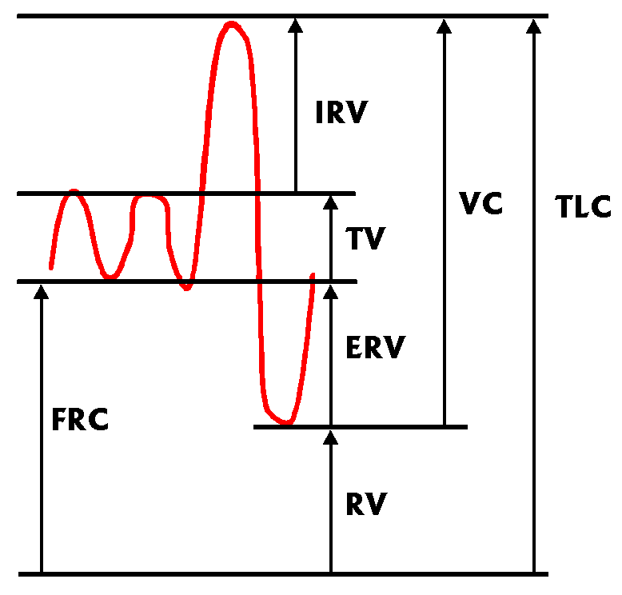
Capacities
Vital capacity – total amount of exchangeable air
Vital capacity = TV + IRV + ERV
Dead space volume – air that never makes it to alveoli
About 150 ml of the 500ml
Measured using a spirometer

Slide 9
Gas transport
Oxygen may be carried 2 ways
Mainly - Attached to hemoglobin molecules of red blood cells = oxyhemoglobin
Dissolved in plasma
Carbon dioxide – transported through plasma as bicarbonate ions – amt in blood determines breathing rate
Conversion to ions occurs in red blood cells
Must be converted back to exit blood
Hypoxia – inadequate oxygen delivery
Caused by anemia, pulmonary disease, blocked blood flow, carbon monoxide

Slide 10
Respiratory Disorders
Rhinitis, tonsillitis, lung cancer, asthma
SIDS – sudden infant death syndrome
Newborn infants stop breathing
May be caused by neural control, viral infection, or heart rhythm abnormalities
Chronic Obstructive Pulmonary Disease (COPD)
Ex. Chronic bronchitis, emphysema
Patients almost always have a history of smoking
Dyspnea (labored breathing) occurs
Coughing

Slide 11
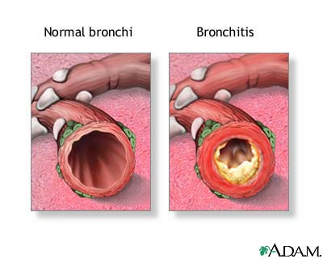
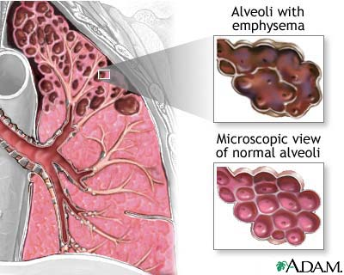
Disorders cont.
Chronic bronchits
Mucosa of lower passages
becomes inflamed and
releases excessive mucus
Emphysema
Lungs lose elasticity/fibrosis
Patients must work to exhale
Apnea – cessation of breathing
Pleurisy – inflammation of the pleura – decrease of fluid =
increase in friction

Slide 12
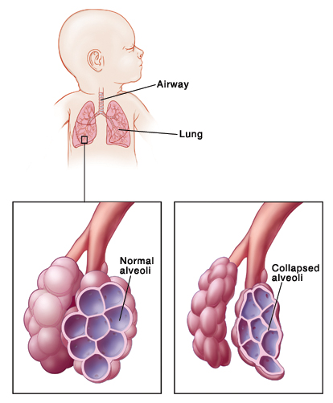
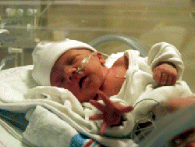
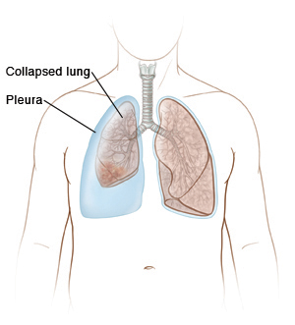
Disorders cont.
Cystic fibrosis – genetic disorder – overproduction of mucus
Infant respiratory distress syndrome (IRDS) – inadequate surfactant – infant must work to reinflate lungs with each breath
Atelectasis – lung collapse

