Slide 1
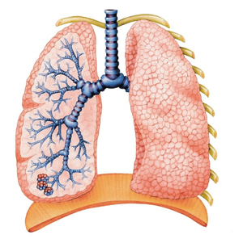
Respiratory System Anatomy
Chapter 13

Slide 2
Nose
Air enters external nares (nostrils)
Nasal cavity – interior
Separated by nasal septum
Lining – respiratory mucosa – moistens and warms air
Conchae – uneven projections – increase surface area
Ciliated cells clean particles from air
Palate separates from oral cavity
Receives tears via nasolacrimal ducts

Slide 3
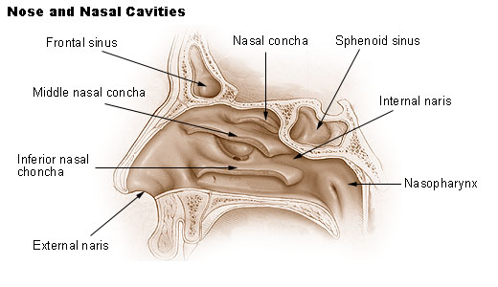
Nose cont.
Paranasal sinuses – surround cavity
Resonance chambers for speech
Produce mucus – drains into nasal cavity
Rhinitis – inflammation of nasal mucosa
May spread into sinuses - sinusitis

Slide 4
Pharynx (throat)
Internal nares connect to nasal cavity
Nasopharynx – superior
Gets drainage from pharyngotympanic tubes
Ear infections may cause sore throat
Oropharynx – middle section
Laryngopharynx – connects to larynx
Tonsils – body defense
Pharyngeal tonsil – adenoid – in nasopharynx
If infected may block pharynx – breath through mouth – tonsillitis
Palatine tonsils – in oropharynx
Lingual tonsils – base of tongue

Slide 5
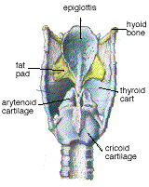
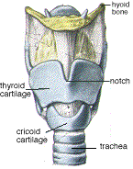
Larynx (voice box)
Composed of 8 hyaline cartilages and 1 elastic cartilage
Largest – thyroid cartilage (Adam’s apple) – anterior
Elastic – epiglottis – blocks entry of food
Vocal folds (vocal cords) – pair of folds – air vibrates slit btw folds - glottis

Slide 6
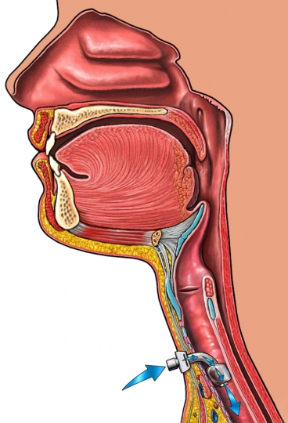
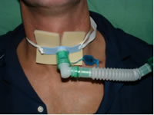
Trachea (wind pipe)
10-12 cm
Anterior to esophagus
Hyaline cartilage gives shape
Ciliated mucosa – lining
Beat opposite air flow – pushes particles away from lungs
Smoking destroys cilia – only coughing rids mucus
Blockage of trachea – choking
Heimlich maneuver
Tracheostomy – opening in trachea

Slide 7
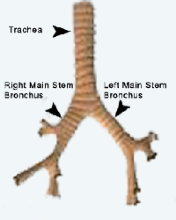
Main Bronchi (right & left)
Trachea divides
Lead to lungs
Right – wider, shorter, and straighter (more likely for blockage)

Slide 8
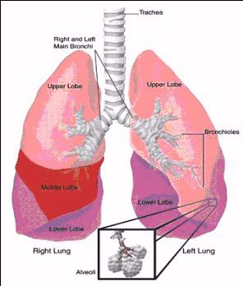
Lungs
Pair
Much elastic connective tissue – soft & spongy
Fill thoracic cavity
Apex – superior
Base – rests on diaphragm
Left lung – 2 lobes
Right lung – 3 lobes

Slide 9
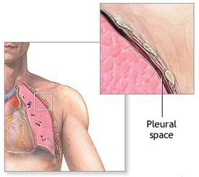
Lung linings
Pulmonary pleura – covers surface
Parietal pleura – lines thoracic cavity
Produce pleural fluid to allow easy movement
Slide by each other but hold close together

Slide 10
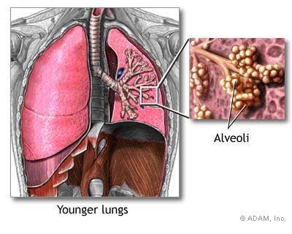
Conducting zones
Bronchi enter and begin branching (bronchial tree)
Bronchioles – smallest branches
Lead to respiratory zone : respiratory bronchioles, alveolar ducts, alveolar sacs, alveoli (site of gas exchange)
Alveoli – bulk of lungs –
millions

Slide 11
Alveoli
Thin squamous epithelial layer (thinner than tissue paper)
Connected to each other by alveolar pores
Covered by capillaries
Respiratory membrane – fusion of vessel walls and alveoli walls
Gas exchange by diffusion
Surface area = 50-70m2 (40X greater than skin)
Macrophages – pick up bacteria/debris
Surfactant – lipid molecule that coats surface
Keeps alveoli from collapsing after each breath

