Slide 1
Chapter 11 Part III
Special Circulation

Slide 2
Brain
Internal carotid arteries – up neck, enter through temporal bone
Divides into anterior and middle cerebral arteries
Supply cerebrum
Vertebral arteries – base of neck
Join and form basilar artery
Supplies brain stem and cerebellum
Splits at base of cerebrum to form posterior cerebral arteries
Supply posterior portion of cerebrum
Connected at circle of Willis by communicating arterial branches
Back up in case of a clot

Slide 3
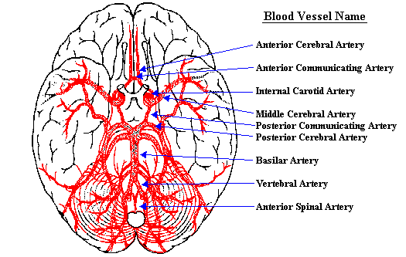

Slide 4
Hepatic Portal Circulation
Drain digestive organs, spleen, and pancreas and take blood to the liver via the hepatic portal vein.
Allows nutrients to be removed for storage/processing
Pathway
Inferior mesenteric vein (drains large intestine) > splenic vein (drains spleen, pancreas, and left portion of stomach) > joins with superior mesenteric vein (drains small intestine) > to form hepatic portal vein
Left gastric vein (drains right portion of stomach) connects directly to hepatic portal vein

Slide 5
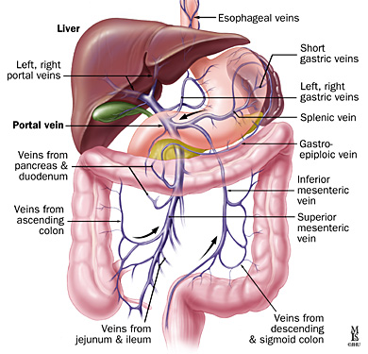

Slide 6
Fetal Circulation
Lungs and digestive system are not functioning and are bypassed.
Umbilical cord
Umbilical vein – carries blood w/ oxygen and nutrients to fetus
2 umbilical arteries – carry carbon dioxide and wastes to placenta
Pathway
Umbilical vein (from placenta)
Ductus venosus – bypasses liver
Inferior vena cava
Right atrium (if it does enter right ventricle,
ductus arteriosus connects aorta to pulmonary trunk
Foramen ovale - connects right/left atria
Left atrium/Left Ventricle/Aorta
Systemic arteries
Umbilical arteries
Placenta

Slide 7
