Slide 1
Circulatory System – Part 2 Vessels
Chapter 11
Functions: transportation of oxygen, nutrients, cell wastes, hormones

Slide 2
aka Vascular system
Pathway from heart
Arteries > arterioles > capillary beds > venules > veins
Exchange btw body cells and blood occurs in capillaries

Slide 3
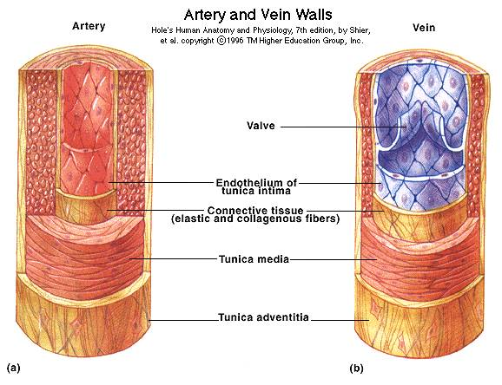
Anatomy
Walls of vessels have 3 coats (tunics) – exception capillaries
Tunica intima – lines lumen (interior)
Made of endothelium w/ slick surface to allow frictionless blood flow
Tunica media – middle
Smooth muscle and
elastic tissue
Constriction & dilation
changes blood pressure
Tunica externa – outer
Fibrous connective tissue
Supports and protects

Slide 4
Arteries/Veins
Arteries
Thicker tunica media
Must stretch w/ each heartbeat
Veins
Have thinner walls
because pressure is
lower
Larger lumens w/
valves to prevent
backflow

Slide 5
Capillaries
Walls have only tunica intima
Allows easy exchange
Form networks – capillary beds
Made of 2 vessel types
Vascular shunt – connects arterioles and venules
Bypasses bed
Begins at terminal arteriole; ends at postcapillary venule
True capillaries – aka exchange vessels
10-100/bed
Precapillary sphincters – regulate flow into bed from shunt

Slide 6
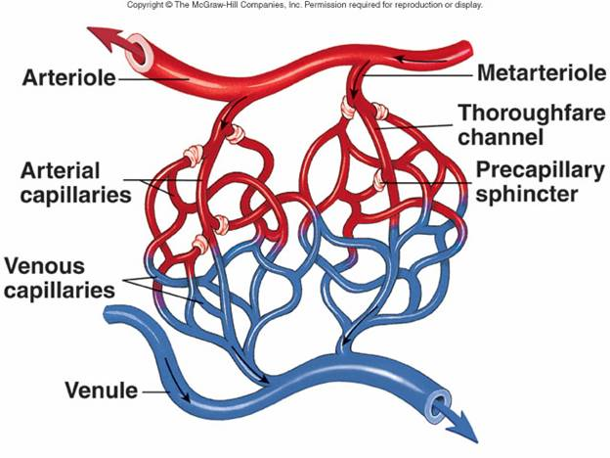
Capillaries cont.

Slide 7
Capillary exchange
Substances tend to move based on concentration gradient
4 ways
Lipid-soluble substances diffuse directly across membranes – gases
Endo or exocytosis if lipid-insoluble
Intercellular clefts – gaps btw tight junctions
Fenestrated capillaries
Fenestra (pores) are found in vessels
Function in absorption and filtration

Slide 8
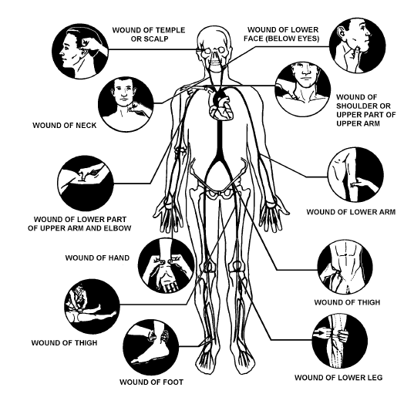
Vital Signs – indicate efficiency
Arterial pulse – alternating expansion
and recoil of an artery
Resting = 70-76 bpm
May press pulse points
to stop blood flow
Aka pressure points
Temporal, facial, carotid,
brachial, radial, femoral, popliteal, posterior tibial, dorsalis pedis

Slide 9
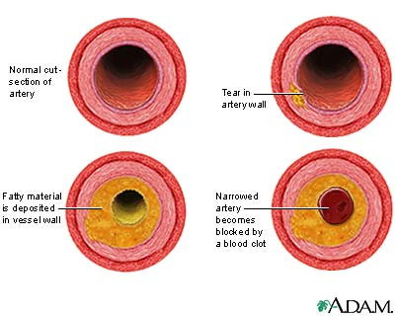
Blood Pressure
Pressure blood puts on inner walls of vessels
Keeps blood circulating
Pressure decreases from arteries to veins
Picture blood flow from a cut
Arteriosclerosis – “hardening of arteries”
Elasticity is lost
Vessels lose ability to
maintain pressure

Slide 10
Blood pressure cont.
Measuring
Systolic pressure – at peak of ventricular contraction
Diastolic pressure – when ventricles relax
Units = millimeters of mercury (mm Hg)
Systolic is written first
Ex. 120/80 mm Hg
Usually measured by auscultatory method
Use brachial artery

Slide 11
Blood pressure cont.
Blood pressure (BP) = CO X Peripheral Resistance (PR)
PR – amt of friction btw blood and vessels
Blood pressure may be altered by
Neural factors
Sympathetic nerves cause vasoconstriction
Triggered by standing suddenly, hemorrhage, vigorous exercise, fright

Slide 12
Blood pressure cont.
Renal factors – kidneys
Help control pressure by regulating water level in blood
Temperature
Cold causes vasoconstriction – prevents swelling
Heat causes vasodilation – speed circulation to an inflamed area

Slide 13
Blood pressure cont.
Chemicals
Epinephrine and nicotine – increase bp
Alcohol and histamine – decrease bp
Diet
Diets low in salt, saturated fat, and cholesterol prevents hypertension (high blood pressure)
Normal = 110-140/75-80
Hypotension – low bp = systolic < 100
Hypertension – high bp = > 140/90
Aka silent killer

Slide 14
Development
Heart first forms as a single tube in the embryo.
By 4th week it’s beating.
During the next 3 weeks it grows into 4 chambers.

