Slide 1
Circulatory System – Part 1 Heart
Chapter 11
Functions: transportation of oxygen, nutrients, cell wastes, hormones

Slide 2
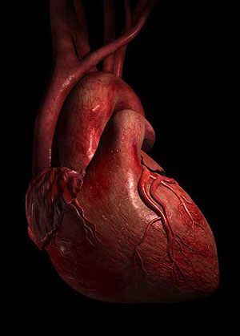
Characteristics
About the size of a fist
Weighs < 1 lb
Location
btw lungs
apex (pointed end) directed
toward left hip and rests on
diaphragm
base points toward right
shoulder and lies under 2nd rib

Slide 3
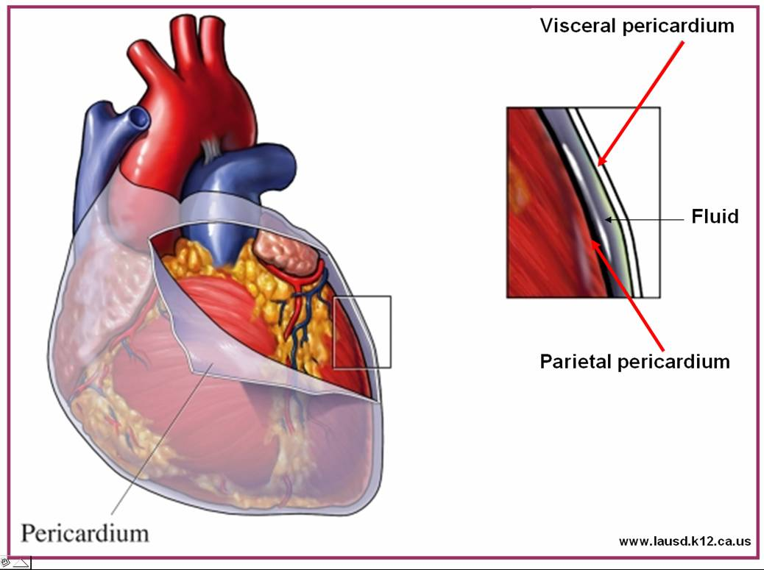
Coverings
Pericardium – double serous membrane
Epicardium – aka visceral pericardium – on heart surface
Parietal pericardium – outer layer of membrane
outside covered by
fibrous membrane
which anchors heart
Serous fluid btw
membranes allows heart
to beat w/out friction

Slide 4
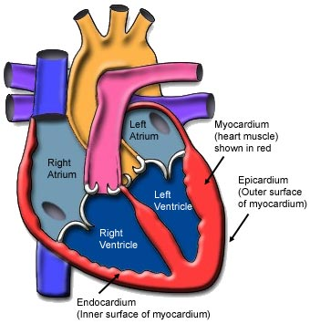
Walls
3 layers
Epicardium
Myocardium – bundles of cardiac muscle
Endocardium – lines the heart chambers

Slide 5
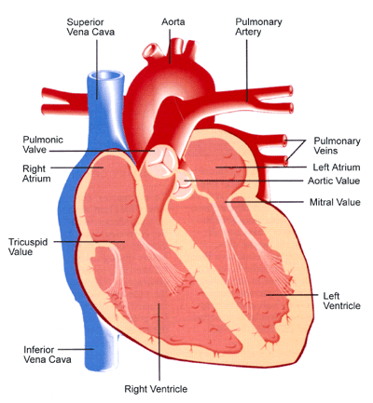
Chambers
2 atria – receiving
chambers
2 ventricles – discharging
chambers
Pumps – contract to
expel blood
Left ventricle forms
apex
Divided longitudinally by
septum
Interventricular or interatrial

Slide 6
Valves – allow blood flow in 1 direction
Atrioventricular (AV) valves – btw atria and ventricles
Bicuspid – aka mitral valve – left side
2 flaps of endocardium
Tricuspid – right side
3 flaps
Anchor to ventricle wall by chordae tendineae
Relaxed ventricle – AV valve flaps are pushed down by flood from atrium
Contracted ventricles push blood against valves causing them to close
Chordae tendineae keep flaps from moving into atrium

Slide 7
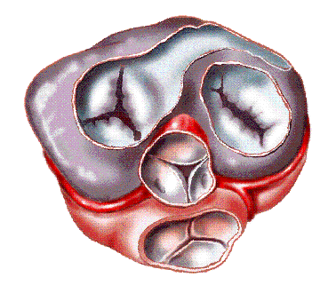
Valves cont.
Semilunar valves – btw ventricles and arteries
Pulmonary semilunar valve
Aortic semilunar valve
Made up of 3 leaflets
Contracting of ventricles forces blood out and pushes leaflets against artery walls
Relaxation allows blood to flow
backward causing leaflets to
close

Slide 8
Pulmonary/Systemic Circulation
Right side = pulmonary circulation
Oxygen poor blood enters the right atrium via superior and inferior venae cavae
Flows to the right ventricle through the tricuspid valve
Pumped out pulmonary trunk (right/left pulmonary arteries) to lungs for oxygen
Reenters heart on left side (left atrium) via pulmonary veins
Left side = systemic circulation
Blood enters left ventricle through bicuspid valve
Blood moves through aorta to all other vessels through body tissues and back to right side
Carries oxygen and nutrients
Left ventricle is larger/thicker because it pumps a longer pathway

Slide 9
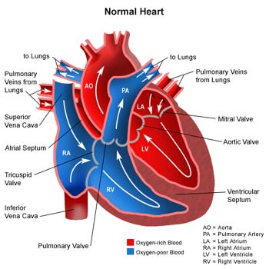
Pulmonary/Systemic Circulation

Slide 10
Cardiac circulation
Provides nutrients to myocardium
Right and left coronary arteries branch off aorta and circle heart in the coronary sulcus (right/left atrioventricular groove)
Compress when ventricles contract; fill when ventricles relax
Drain to cardiac veins to coronary sinus on back of heart which leads to right atrium
If heart beats too quickly – coronary arteries don’t have a long enough relaxation period to fill and myocardium may be deprived of oxygen
Leads to pain – angina pectoris
Heart cells may die – form an infarct
Myocardial infarction = heart attack

Slide 11
Intrinsic conduction system
Sets the heart’s basic rhythm = 75 bpm
Sinoatrial (SA) node – in right atrium
Aka pacemaker
Starts each heartbeat and sets pace
Impulse moves through atria to atrioventricular (AV) node where it pauses to allow atria time to contract
Then moves down ventricles through the atrioventricular (AV) bundle (bundle of His) to the right/left bundle branches and into the Purkinje fibers found in ventricle walls
Contraction begins at apex and moves up ventricle walls toward atria pushing blood up and out arteries

Slide 12
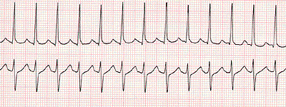
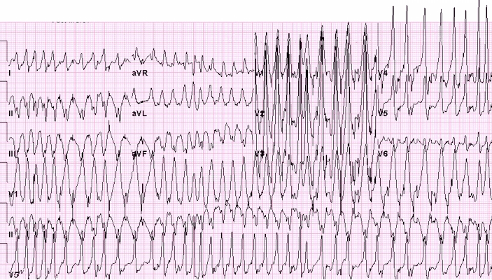
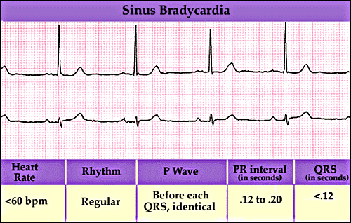
Tachycardia – rapid heartbeat - >100 bpm
Bradycardia – slower than normal - < 60 bpm
Fibrillation – uncontrolled shuddering
In 1 day heart pushes 6 quarts of blood through vessels over 1000 times
Pumps about 6000 quarts/day

Slide 13
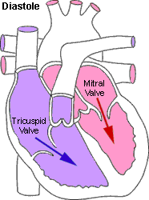
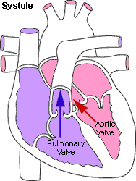
Cardiac cycle – 1 complete heartbeat
About .8 sec
Stages
Mid-to-late diastole (relaxation)
Atria pump blood to ventricles
Semilunar valves are closed; AV valves are open
Systole (contraction) begins – ventricular stroke
Pressure increases causing AV valves to close and semilunar valves to open
Blood enters arteries
Atria are relaxed and refilling
Early diastole
Semilunar valves close
Ventricles are empty; pressure decreases
AV valves open and refill ventricles

Slide 14
Heart Sounds
Lub dup pause
Lub = AV valves closing
Dup = semilunar valves closing
Murmurs – abnormal sounds
May indicate a valve problem

Slide 15
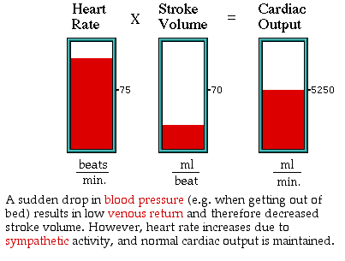
Cardiac output (CO)
CO – amt of blood pumped out by each side of heart in 1 minute
CO = heart rate X stroke volume (sv)
Stroke volume = amt of blood pumped by a ventricle w/ each heartbeat – 70 ml/min is average
CO = HR (75bpm) X sv (70ml/min) = 5250 ml/min
Normal blood amt = 5000 ml
In 1 minute, entire blood supply
circulates

Slide 16
Venus Return
Regulation of stroke volume
Starling’s law of the heart – how much cardiac muscle is stretched just before contraction controls stroke volume
Greater stretch = greater contraction
Amt of blood entering and stretching ventricles
If 1 side pumps more blood, the increased venus return to opposite ventricle will cause it to pump equal amount
Healthy = constant stroke volume
Sudden decrease in blood volume causes decrease in stroke volume
CO is maintained by faster heartbeat

Slide 17
Neural controls
Neural Controls
Sympathetic nerves may stimulate SA and AV nodes because of physical/emotional stress = faster heartbeat
Parasympathetic nerves – slow and steady heart – allow time to rest
Congestive heart failure – heart is worn out
Epinephrine and thyroxine – hormones that increase heartrate
Age, gender, exercise, and body temp affect heartrate

