Slide 1
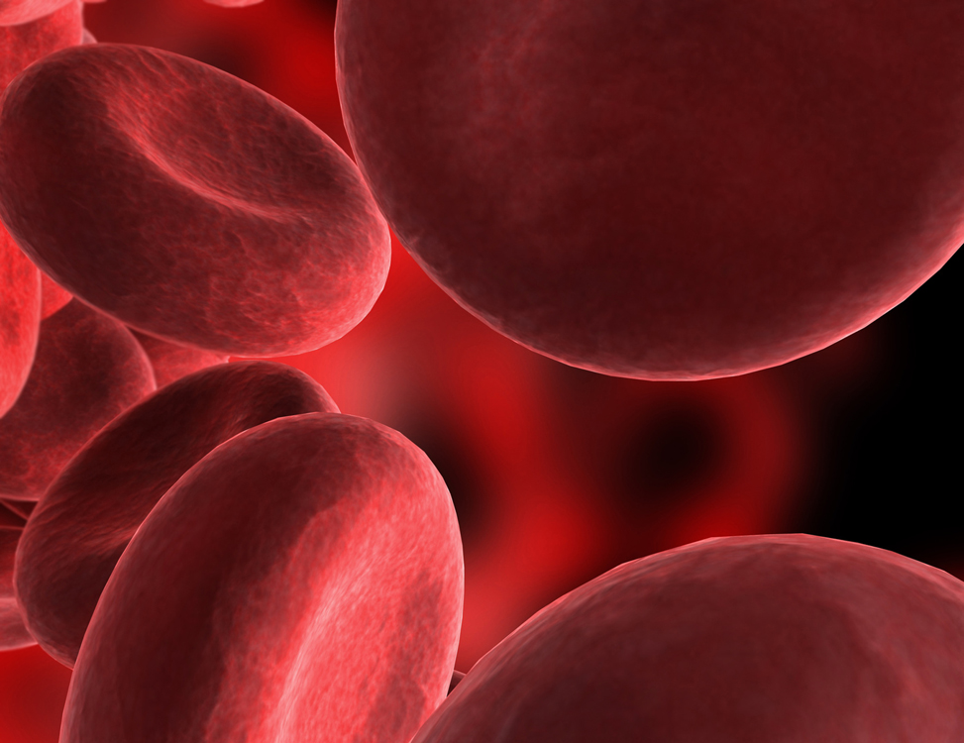
BLOOD
Chapter 10

Slide 2
Characteristics
Only fluid (connective) tissue.
Opaque
Metallic taste
Color – scarlet to dull red
Depends on oxygen
pH btw 7.35 to 7.45
temp 100.4 F (38C)
higher than normal body temp
8% of body weight
About 5-6 liters or 6 quarts

Slide 3
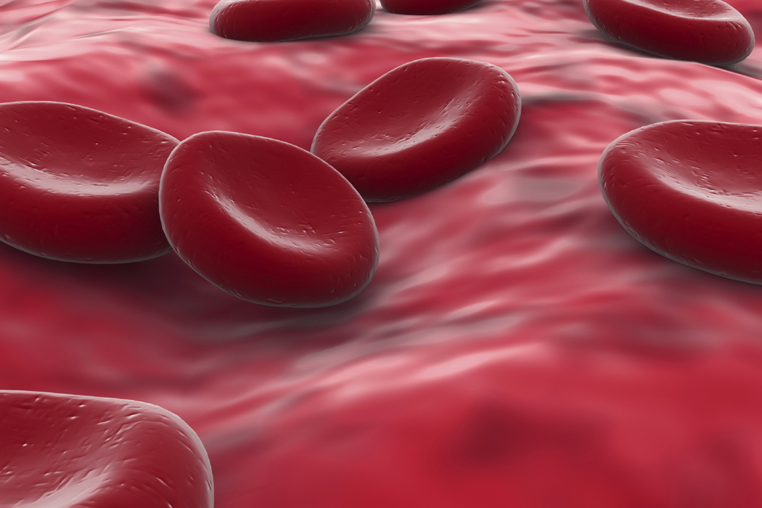
Formed Elements
Erythrocytes – red blood cells (RBCs)
45% of blood
Anucleate – no nucleus
Contain hemoglobin
molecules
Iron bearing protein
Transports most of the oxygen
1RBC = 250 million hmg
molecules
1hmg can hold 4 oxygen
molecules
Biconcave discs
About 5 million cells/mm3
More/less RBCs causes blood to thicken/thin
Form hematocrit of spun blood

Slide 4
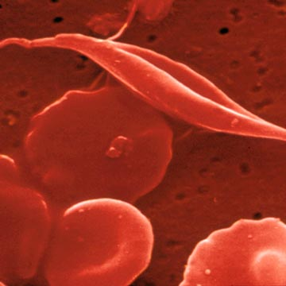
Formed elements cont.
Anemia – decrease in oxygen carrying
ability
Sickle cell anemia – abnormal hmg
causes RBC to become spiky and rupture easily
Aplastic anemia – destruction of bone
marrow by cancer
Iron-deficiency anemia – lack of iron in diet or slow/prolonged bleeding
Decrease in RBC #
Pernicious anemia – lack of vitamin B12
Hemorrhagic anemia – hemorrhage
Hemolytic anemia – bacterial infection causes lysis of RBCs

Slide 5
Formed elements cont.
Polycythemia – increase in # of RBCs
Causes
Bone marrow cancer
Living at high altitudes
Thicker blood may move sluggishly and impair circulation

Slide 6
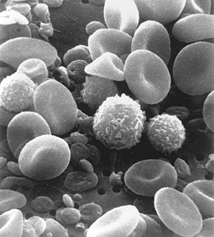
Formed elements cont.
Leukocytes – white blood cells (WBCs)
4000 to 11000/mm3
< 1% of total blood volume
Are complete cells
Diapedesis – WBCs can move
in/out of vessels to reach
infected/inflamed areas
Positive chemotaxis – WBCs
respond to chemicals released
by damaged cells

Slide 7
Formed elements cont.
When needed their # doubles
>11000 = leukocytosis
Indicates an infection
<4000 = leukopenia
Caused by some drugs – corticosteroids and anticancer agents
Leukemia – bone marrow produces large #s of WBCs that are unable to function

Slide 8
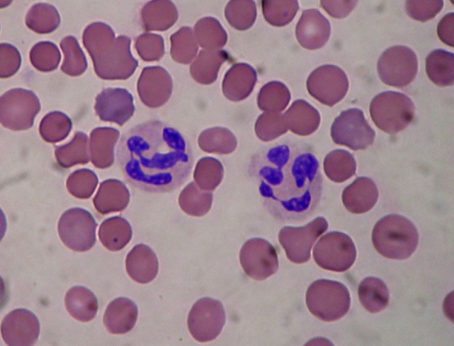
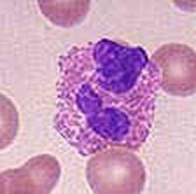
Formed elements cont.
2 groups – based on visible granules
Granulocytes – lobed nuclei
Neutrophils – multilobed nuclei
Most numerous/phagocytic
Fine granules
@ sites of acute infections
Eosinophils – blue-red nucleus
Large granules
Respond to allergies and infections by worms
Basophils – rarest
U or S shaped nuclei
Granules w/ histamine – attracts other WBCs to inflamed site

Slide 9
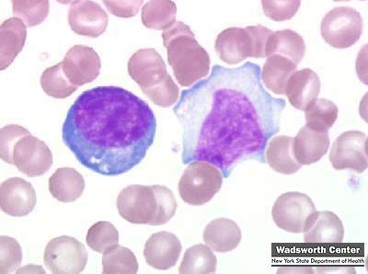
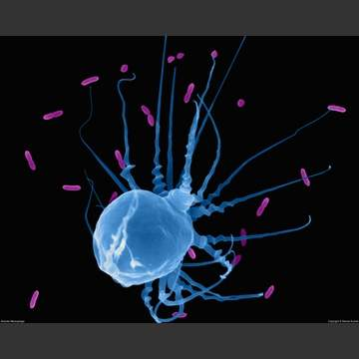
Formed elements cont.
Agranulocytes – normal nuclei
Lymphocytes
Large purple nucleus
In lymphatic tissue
Immune system
Monocytes – largest
Change into macrophages
Fight chronic infections

Slide 10
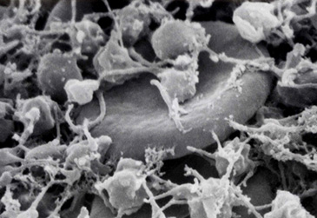
Formed elements cont.
Platelets – fragments of multinucleate cells called megakaryocytes
300,000/mm3
Blood clotting
Cling to broken
area

Slide 11
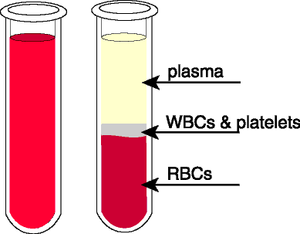
Plasma
Nonliving fluid matrix
55% of blood
90% water
Straw color
Includes nutrients, salts, gases, hormones, wastes, and plasma proteins
Plasma proteins
Produced by liver
Albumin – contributes to
osmotic pressure
Keeps water in bloodstream
Clotting proteins
Antibodies – protect from pathogens

Slide 12
Human Blood Groups
Plasma membranes of RBCs have proteins (cellular or self antigens)
Antigens – substances the body recognizes as foreign
Stimulate the immune system to release antibodies
Antibodies in plasma attach to surface antigens different from those of the individual
Agglutination – clumping of cells due to antibodies
Leads to clogging of vessels and lysis of foreign cells
Lysis releases hmg which may clog kidney tubules = kidney failure

Slide 13
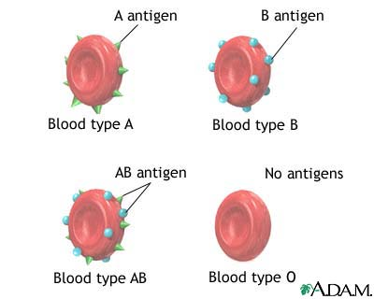
Blood groups cont.
ABO blood group
Based on 2 antigens – type A or type B
Absence of both = type O
– universal donor
Presence of both = type AB
– universal recipient
From birth your body contains antibodies for the ABO antigens not present – anti-A or anti-B antibodies

Slide 14
Blood groups cont.
Rh blood group
Rh+ = Rh antigen is present
Rh- = Rh antigen is absent
anti-Rh antibodies do not form until exposed to Rh+ blood
Rh- women have to be careful when pregnant
1st Rh+ baby – health
2nd Rh+ baby – mother’s body now has antibodies and will attempt to destroy RBCs of the baby = hemolytic disease of the newborn
May prevent by taking RhoGAM shortly after the birth of her 1st Rh+ baby – prevents production of antibodies

Slide 15
Blood Typing
Test blood by mixing with anti-A and anti-B immune serum.
Agglutination will occur btw the antibody and the corresponding antigen (if present).
Type AB – contains
antigens A and B – will
agglutinate with both antibodies
Type B – contains antigen B
– agglutinates with anti-B
Type A – contains antigen A
– agglutinates with anti-A
Type O – no antigens – no
agglutination occurs

Slide 16
Hematopoiesis – blood cell formation
Occurs in myeloid tissue (red bone marrow)
Hemocytoblast – stem cell in marrow that produces formed elements
Forms 2 types of secondary stem cells
Lymphoid stem cells – produce lymphocytes
Myeloid stem cells – produce erythrocytes and platelets
Fully formed RBCs do not grow or divide
Life span btw 100-120 days
Become rigid and break apart
Spleen and liver get rid of pieces

Slide 17
Hematopoiesis cont.
RBC Development – 3-5 days
Young RBCs divide until enough hmg is produced
Then eject nucleus and all organelles except ER
Called a reticulocyte
Enter bloodstream
w/in 2 days of release eject ER
Become erythrocytes
Erythropoietin – hormone – controls production rate
Produced at a constant rate by kidneys
Decrease in oxygen = increase in production

Slide 18
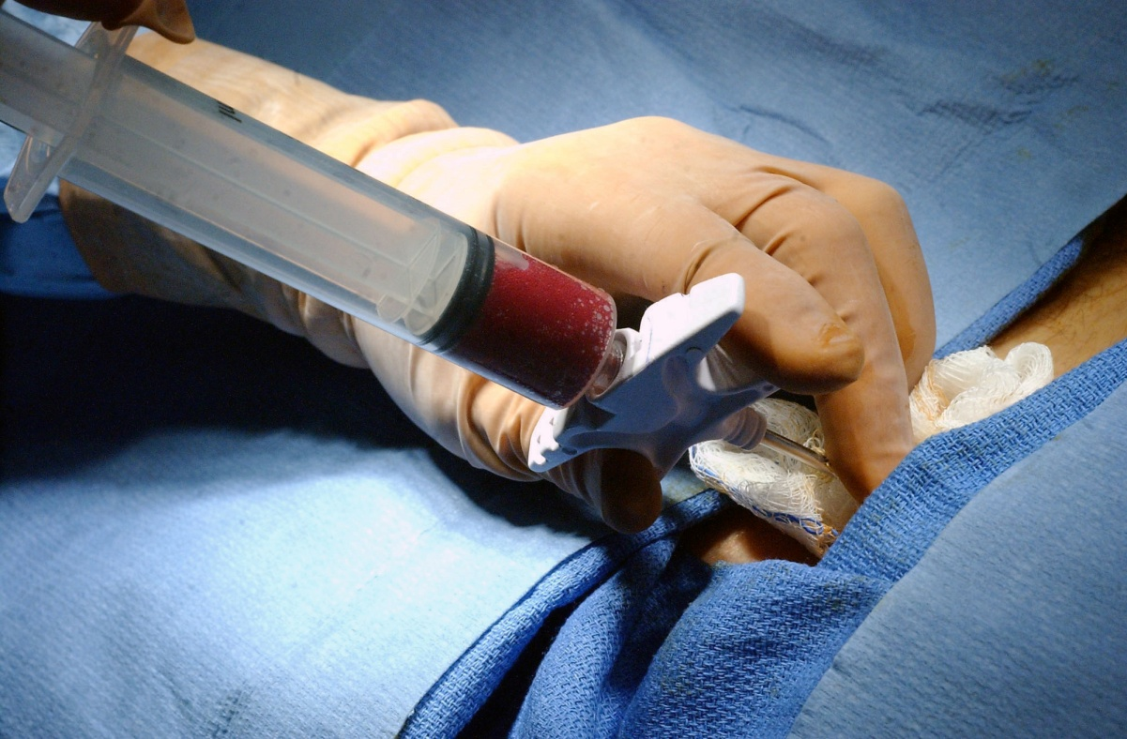
Hematopoiesis cont.
WBCs – production stimulated by colony stimulating factors (CSFs) and interleukins
Platelets – production stimulated by thrombopoietin
Bone marrow biopsy – taking a sample for examination

Slide 19
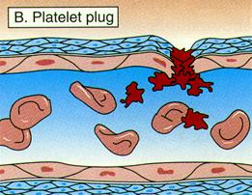
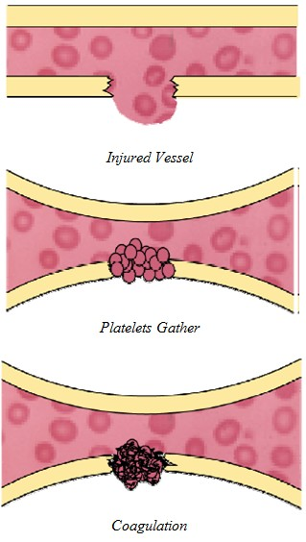
Maintaining hemostasis (stoppage of blood flow)
Occurs when vessel walls break
3 phases
Platelet plug forms – aka white thrombus
Platelets stick to damaged site
Vascular spasms occur
Platelets release serotonin – causes spasms
Slow blood loss until clot forms
Coagulation events occur
Tissues release tissue factor (TF)
PF3 (on platelets) reacts w/ TF, vitamin K, and
Ca to trigger clotting cascade
Prothrombin activator converts prothrombin in plasma
to thrombin
Thrombin joins fibrinogen to form fibrin (mesh) to
capture RBCs

Slide 20
Hemostasis cont.
Usually takes w/in 3-6 minutes
Disorders
Undesirable clotting
Thrombus – clot in an unbroken vessel
May cause blockage
Embolus – thrombus that floats in bloodstream
May move to brain – stroke
Bleeding disorders
Thrombocytopenia – insufficient # of platelets
Hemophilia – genetic – lack any factors needed for clotting

Slide 21
Development
Embryonic blood cells are circulating by day 28
Fetal hemoglobin (HbF) is present – can carry more oxygen
At birth fetal cells are broken down
If broken down too fast for liver – physiologic jaundice may occur

