Slide 1
The Evolution of Populations

Slide 2
Population genetics
Population: a localized group of individuals belonging to the same species
Different pops. of the same species may interact yet more likely to mate w/ members of own pop.
Species: a group of populations whose individuals have the potential to interbreed and produce fertile offspring
Gene pool: the total aggregate of genes in a population at any one time
Population genetics: the study of genetic changes in populations
Modern synthesis/neo-Darwinism
“Individuals are selected, but populations evolve.”

Slide 3
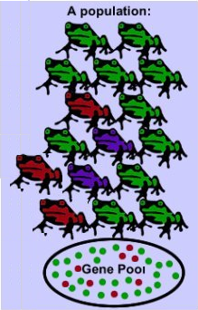
Evolution
Evolution is defined as a change in the inherited characteristics of biological populations over successive generations.
Microevolution involves the change in allele frequencies that occur over time within a population.
This change is due to four different processes: mutation, selection (natural and artificial), gene flow, and genetic drift.

Slide 4
Determining Allele Frequency
Examine the frog population presented here.
Their color is determined by a single gene, which has two alleles and phenotypically exhibits incomplete dominance.
C^{G}C^{G} is green, C^{G} C^{R} is blue, and C^{R} C^{R} is red
Calculate the allele frequency of the gene pool in the diagram.

Slide 5
Determining Allele Frequency
These frogs are diploid, thus have two copies of their genes for color.
If allelic frequencies change, then evolution is occurring.
Let’s suppose 4 green frogs enter the population (immigration). How do the frequencies change?
Allele: | C^{G} | C^{R}
Green (11) | 22 | 0
Blue (2) | 2 | 2
Red (3) | 0 | 6
Total: | 24 | 8
Frequency: | p = 24 ÷ 32 p = ¾ = 0.75 | q = 8 ÷ 32 q = ¼ = 0.25

Slide 6
Immigration: Determining Allele Frequency
Recall that currently: C^{G} = 0.75 & C^{R} = 0.25
Allele: | C^{G} | C^{R}
Green (15) | 30 | 0
Blue (2) | 2 | 2
Red (3) | 0 | 6
Total: | 32 | 8
Frequency: | p = 32 ÷ 40 p = 8/10 = 0.80 | q = 8 ÷ 40 q = 2/10 = 0.20

Slide 7
Determining Allele Frequency
How do the allelic frequencies change if 4 green frogs leave the population instead of enter the population? (emigration)

Slide 8
Emigration: Determining Allele Frequency
Recall that originally: C^{G} = 0.75 & C^{R} = 0.25
Allele: | C^{G} | C^{R}
Green (7) | 14 | 0
Blue (2) | 2 | 2
Red (3) | 0 | 6
Total: | 16 | 8
Frequency: | p = 16 ÷ 24 p = 2/3 = 0.67 | q = 8 ÷ 24 q = 1/3 = 0.33

Slide 9
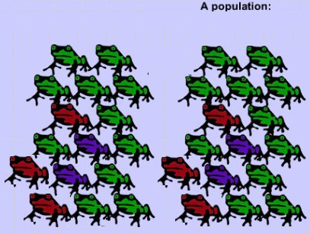
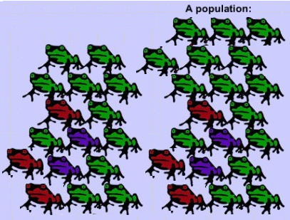
Impact On Small vs. Large Population
Before 4 frogs joined After 4 frogs joined
Compare the effect on the small population to 4 frogs joining a much larger population.

Slide 10
Impact Large Population
Before 4 frogs joined After 4 green frogs joined larger population larger population
Allele: | C^{G} | C^{R}
Green (22) | 44 | 0
Blue (4) | 4 | 4
Red (6) | 0 | 12
Total: | 48 | 16
Frequency: | p = 48 ÷ 64 p = 3/4 = 0.75 | q = 16 ÷ 64 q = 1/4 = 0.25
Allele: | C^{G} | C^{R}
Green (26) | 52 | 0
Blue (4) | 4 | 4
Red (6) | 0 | 12
Total: | 56 | 16
Frequency: | p = 5 ÷ 72 p = 56/72 = 0.78 | q = 16 ÷ 72 q = 16/72 = 0.22

Slide 11
Impact Small Population
Before 4 frogs joined After 4 green frogs joined
Allele: | C^{G} | C^{R}
Green (11) | 22 | 0
Blue (2) | 2 | 2
Red (3) | 0 | 6
Total: | 24 | 8
Frequency: | p = 24 ÷ 32 p = ¾ = 0.75 | q = 8 ÷ 32 q = ¼ = 0.25
Allele: | C^{G} | C^{R}
Green (15) | 30 | 0
Blue (2) | 2 | 2
Red (3) | 0 | 6
Total: | 32 | 8
Frequency: | p = 32 ÷ 40 p = 8/10 = 0.80 | q = 8 ÷ 40 q = 2/10 = 0.20
In both cases the allele frequency for C^{G} increases but it has a bigger impact on the smaller population.

Slide 12
Hardy-Weinberg Theorem
Serves as a model for the genetic structure of a nonevolving population (equilibrium – frequency of alleles is not changing)
5 conditions:
1- Very large population size;
2- No migration;
3- No net mutations;
4- Random mating;
5- No natural selection
Departure from these results in
evolution.
Rarely found in nature – some pops evolve so slowly they appear to be in equilibrium

Slide 13
Hardy-Weinberg Equation
p=frequency of the dominant allele (A)
q=frequency of the recessive allele (a)
p+q=1.0 (100% of alleles) (p=1-q & q=1-p)
p²=frequency of AA genotype
2pq=frequency of Aa plus aA genotype
q²=frequency of aa genotype
p² + 2pq + q² = 1.0 (100% of population)
Can be used to estimate % of pop carrying a certain allele.

Slide 14
Applying the H-W Model
Here we go with our frogs again! Let’s suppose that in a population of 100 frogs, 36 were green (C^{G}C^{G}), 48 were blue (C^{G}C^{R}) and 16 were red (C^{R}C^{R}) and there was total random mating.
Thus, it can be assumed that 60% of all the gametes (eggs and sperm) should carry the C^{G} allele and 40% of the gametes should carry the C^{R} allele.
Allele: | C^{G} | C^{R}
Green (36) | 72 | 0
Blue (48) | 48 | 48
Red (16) | 0 | 32
Total: | 120 | 80
Frequency: | p = 120 ÷ 200 p = 3/5 = 0.60 | q = 80 ÷ 200 q = 2/5 = 0.40

Slide 15
Applying the H-W Model
 | C^{G} 0.60 | C^{R} 0.40
C^{G} 0.60 | C^{G}C^{G} 0.36 | C^{G}C^{R} 0.24
C^{R} 0.40 | C^{G}C^{R} 0.24 | C^{R}C^{R} 0.16
A population Punnett square is shown above. It indicates that the next generation should have the following offspring distribution: 36% green (C^{G}C^{G}), 48% blue(C^{G}C^{R}), 16% red (C^{R}C^{R}). When the second generation gets ready to reproduce, the results will be the same as before.
Allele: | C^{G} | C^{R}
Green (36) | 72 | 0
Blue (48) | 48 | 48
Red (16) | 0 | 32
Total: | 120 | 80
Frequency: | p = 120 ÷ 200 p = 3/5 = 0.60 | q = 80 ÷ 200 q = 2/5 = 0.40

Slide 16
Applying the H-W Model
So, the allele frequency remains at 0.40 C^{G} and 0.60 C^{R} thus no evolution is taking place.
Let’s suppose that there is an environmental change that makes red frogs more obvious to predators. How is the population affected and now the population consists of 36 green, 48 blue, and 6 red frogs?
Now, allele frequencies are changing and there is an advantage to being green or blue but NOT red. Evolution is indeed occurring.
Allele: | C^{G} | C^{R}
Green (36) | 72 | 0
Blue (48) | 48 | 48
Red (6) | 0 | 12
Total: | 120 | 60
Frequency: | p = 120 ÷ 180 p = 2/3 = 0.66 | q = 60 ÷ 180 q = 1/3 = 0.33

Slide 17
Deriving the H-W Model
 | C^{G} 0.60 | C^{R} 0.40
C^{G} 0.60 | C^{G}C^{G} 0.36 | C^{G}C^{R} 0.24
C^{R} 0.40 | C^{G}C^{R} 0.24 | C^{R}C^{R} 0.16
Examine this Punnett square again. If p represents the allele frequency of C^{G} (dominant) and q represents the allele frequency of C^{R} (recessive) then two equations for a population in Hardy-Weinberg equilibrium can be derived where the following genotypes are represented by:
C^{G}C^{G} = p² C^{R}C^{R} = q² C^{G}C^{R} = 2pq
Mathematically then p + q = 0.60 + 0.40 = 1 (1st H-W equation)
So, the Punnett square effectively crossed (p + q ) × (p + q ) which gives p² + 2pq + q² = 1 (2nd H-W equation)

Slide 18
Microevolution
A change in the gene pool of a population over a succession of generations
1. Genetic drift: changes in the gene pool of a small population due to chance (usually reduces genetic variability)

Slide 19
Microevolution
The Bottleneck Effect: type of genetic drift resulting from a reduction in population (natural disaster) such that the surviving population is no longer genetically representative of the original population
Human actions may cause bottlenecks in other species (endangered)

Slide 20
Microevolution
Founder Effect: a cause of genetic drift attributable to colonization by a limited number of individuals from a parent population
Isolation bottleneck

Slide 21
Microevolution
2. Gene Flow: genetic exchange due to the migration of fertile individuals or gametes between populations (reduces differences between populations)
Increases variation w/in a pop.

Slide 22
Microevolution
3. Mutations: a change in an organism’s DNA (gametes; many generations); original
source of genetic variation (raw material for natural selection)
Must occur in gametes to
be passed on – somatic
cells make no difference
Many are harmful, so they
do not spread
Point, frameshift
Sexual recomb. – different genetic backgrounds are brought together leading to fresh combos

Slide 23
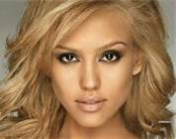
Microevolution
4. Nonrandom mating: inbreeding and asortive mating (both shift frequencies of different genotypes)
Slow to cause evolutionary change
Let’s revisit our adorable frogs and suppose that 4 frogs migrate to a pond some distance from the main pond.
It is likely that these 4 frogs will mate with one another, leaving the rest of the population in the main pond behind to also mate with one another.
Nonrandom mating implies a choice of mates which is more prevalent in animals.

Slide 24
Microevolution
5. Natural Selection: differential success in reproduction; only form of microevolution that adapts a pop to its environment
Acts on phenotype not genotype
Consistently increases the frequencies of alleles that provide reproductive advantage and thus leads to adaptive evolution.

Slide 25
Natural selection
Fitness: contribution an individual makes to the gene pool of the next generation
Sterile – fitness = 0
3 types of Natural Selection:
alter the frequency distribution of heritable traits in three ways depending on which phenotype is favored:
A. Directional
B. Diversifying
(Disruptive)
C. Stabilizing

Slide 26
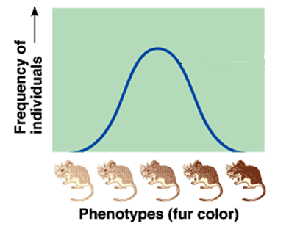
Directional Selection
Directional selection occurs when conditions favor individuals exhibiting one extreme of a phenotypic range.
Commonly occurs when the population’s environment changes or when members of a population migrate to a new (and different) habitat.

Slide 27
Disruptive or Diversifying Selection
Disruptive selection occurs when conditions favor individuals at both extremes of a phenotypic range over individuals with intermediate phenotypes.
The “intermediates” in the population have lower relative fitness.
Polymorphism: coexistence of 2 or more distinct forms of individuals (morphs) within the same population

Slide 28
Stabilizing Selection
Stabilizing selection removes extreme variants from the population and preserves intermediate types.
This reduces variation and tends to maintain the status quo for a particular phenotypic character.

Slide 29
Variation preservation
Prevention of natural selection’s reduction of variation
Diploidy 2nd set of chromosomes hides variation in the heterozygote
Balanced polymorphism
Heterozygote advantage – hybrid vigor; i.e., malaria/sickle-cell anemia
Frequency dependent selection – survival & reproduction of any 1 morph declines if it becomes too common; i.e., parasite/host
Birds learn to look for most common moths

Slide 30
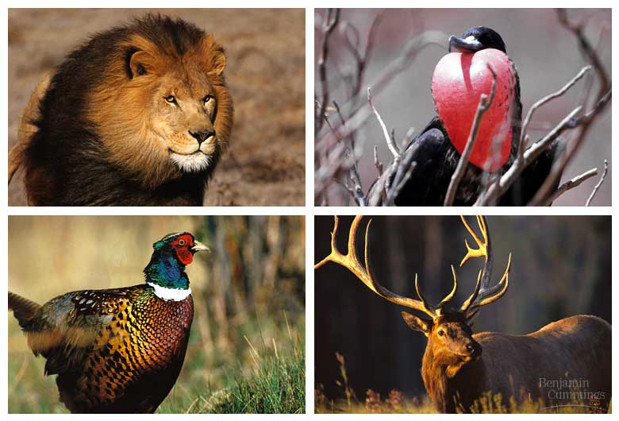
Sexual selection
Natural selection for mating success
Sexual dimorphism: secondary sex characteristic distinction
Sexual selection: selection towards secondary sex characteristics that leads to sexual dimorphism
Intrasexual selection – direct competition
Intersexual selection – mate choice

