Slide 1
The Origin of Species

Slide 2
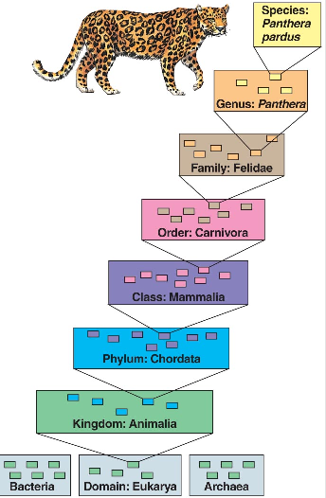
Taxonomy
Originated with Linnaeus in the 18th century.
Based on structural (outward & inward) similarities
Hierarchal scheme, the largest most inclusive grouping is the kingdom level
Domains added in 1990
The most specific grouping is the species level

Slide 3
Taxonomy
A species’s scientific name is Latin and composed of two words: Genus followed by specific epithet (description)
So, the cheetah’s scientific name is Acinonyx jubatus
Taxonomy is the classification of organisms based on shared characteristics.

Slide 4
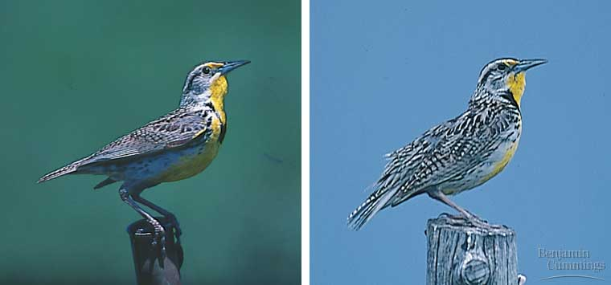
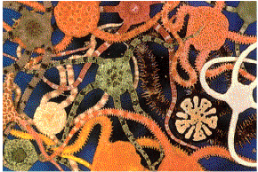
Looks Can Be Deceiving!
These meadowlarks look very similar yet they are not the same species.
By contrast, these brittle stars look very different from one another, but they are the same species.

Slide 5
What is a species?
Biological species concept (Mayr): proposed in 1942
A population or group of pops whose members have the potential to interbreed and produce viable, fertile offspring (genetic exchange is possible and that is genetically isolated from other populations)
Cannot produce viable, fertile offspring w/ other populations

Slide 6
Other species concepts – apply to sexual & asexual
Morphological – characterizes a species by body shape, size, & structural features
Paleontological – focuses on species known only by fossil record
Ecological – views species in terms of ecological niche & its role in a biological community
Phylogenetic – a set of organisms w/ a unique genetic history

Slide 7
Macroevolution: the origin of new taxonomic groups
Speciation: the origin of new species
Anagenesis (phyletic evolution): gradual accumulation of heritable changes w/in the entire population
Cladogenesis (branching evolution): budding of new species from a parent species that continues to exist (basis of biological diversity)
One gene pool splits into 2 or more (physical separation) which give rise to a new species

Slide 8
Reproductive Isolation (isolation of gene pools)
Prezygotic barriers: impede mating between species or hinder the fertilization of the ova if members of different species attempt to mate
Habitat (snakes; water/terrestrial)
Behavioral (fireflies, blue-footed boobie; mate signaling/courtship)
Temporal (salmon, spotted skunks; seasonal mating)
Mechanical (flowers; pollination anatomy/different pollinators)
Gametic (frogs, sea urchins; egg coat receptors)

Slide 9
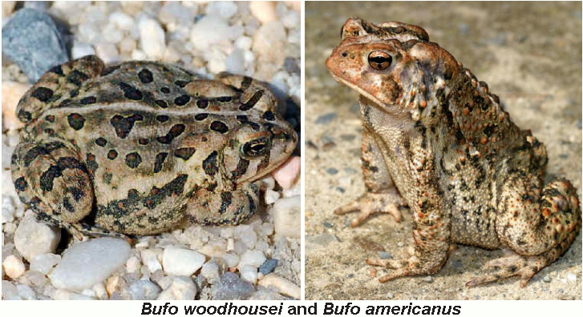
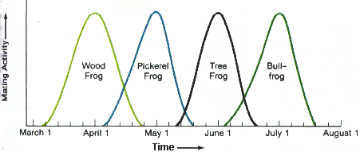
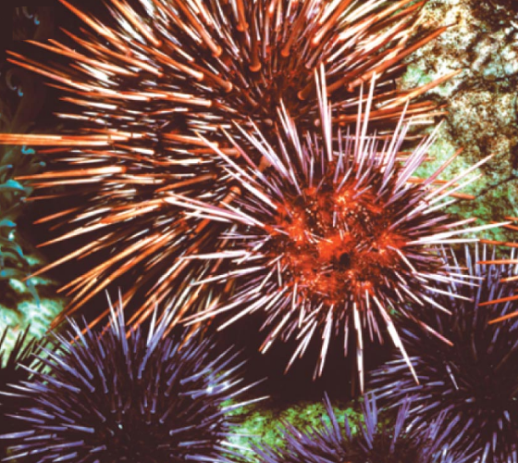
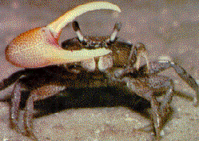
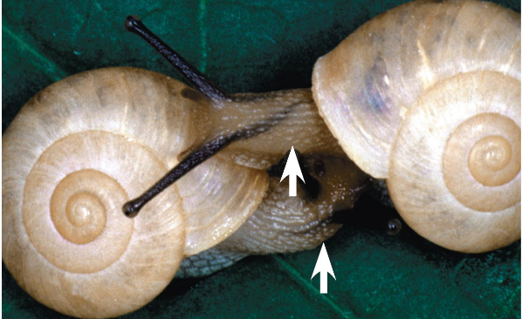
Bufo woodhousei and Bufo americanus are two closely related toads. B. woodhousei prefers to reproduce in the quiet water of a stream whereas B. americanus prefers to reproduce in shallow rain-pools. As a result, they remain separate species.
Twelve fiddler crab species inhabit a certain beach in Panama. Males of each species have distinctive mating displays which include waving claws, elevating the body, and moving around the burrow.
The Bradybaena shown are two different species of snails because the shells spiral in opposite directions, thus they are unable to mate with one another.
Notes:
Another example- The dragonflies Progomphus obscurus and Progumphus alachuensis are closely related. In places where their range overlaps, P. obscurus reproduces in streams whereas P. alachuensis reproduces in lakes.
Another example: Two species of buckthorn shrubs, Ceanothus thysifbrus and Canothus denatus have ranges that overlap in California but C. thysifbrus is found in moist hills with good soil and C. denatus is found in drier, poor, and shallow soil.
Graphic http://www.google.com/imgres?q=Bufo+woodhousei&hl=en&noj=1&tbm=isch&tbnid=hlC-q-67L9H4kM:&imgrefurl=http://216.158.40.136/NorthCarolinaAmphibs%26Reps.htm&docid=9w-oHYps-6ov1M&imgurl=http://216.158.40.136/NorthC9.jpg&w=618&h=413&ei=HQZrUJy4Js_NqQGghICwCA&zoom=1&iact=hc&vpx=844&vpy=198&dur=2175&hovh=183&hovw=275&tx=150&ty=95&sig=115159201469248240313&page=1&tbnh=154&tbnw=223&start=0&ndsp=15&ved=1t:429,r:3,s:0,i:96&biw=1350&bih=719

Slide 10
Reproductive Isolation
Postzygotic barriers: fertilization occurs, but the hybrid zygote does not develop into a viable, fertile adult
Reduced hybrid viability (frogs, salamanders; zygotes fail to develop or reach sexual maturity)
Reduced hybrid fertility (mule; horse x donkey; cannot backbreed)
Hybrid breakdown (cotton, rice; 2nd generation hybrids are sterile)

Slide 11
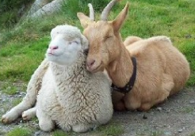
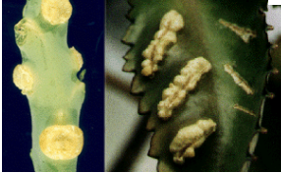
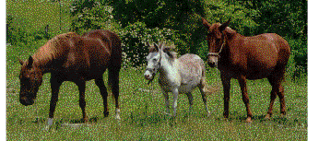
Sheep belong to the genus Ovis and have 54 chromosomes, while goats belong to the genus Capra and have 60 chromosomes. When goats and sheep mate, they produce embryos that die prior to birth.
When tobacco hybrids are successful, they often form tumors. These tumors are located in their vegetative parts. Often no flowering occurs, thus no reproduction occurs.
A mule is the result of female horse crossed with a male donkey. Mules are sterile, thus there is no potential for gene flow. In terms of evolution it is a dead end. The horse is on the left, the donkey is in the center and the mule is on the right.
Notes:
Graphic http://www.google.com/imgres?q=goat+and+sheep&num=10&hl=en&biw=1350&bih=719&tbm=isch&tbnid=p2YUYLOBeWF45M:&imgrefurl=http://thoughtsfrompastorsteve.blogspot.com/2011/11/last-weeks-sermon-message-was-titled.html&docid=GV-E4o83fxpskM&imgurl=http://2.bp.blogspot.com/-T0PszgYxwGk/Tswkan1PWGI/AAAAAAAAAm8/lX2G9eeQBns/s1600/sheep_goats.jpg&w=266&h=194&ei=hGRrUNGTG8Go2wWSqYDACA&zoom=1&iact=hc&vpx=410&vpy=354&dur=15&hovh=155&hovw=212&tx=126&ty=79&sig=115159201469248240313&page=1&tbnh=155&tbnw=212&start=0&ndsp=15&ved=1t:429,r:6,s:0,i:92Another example-The eggs of fish can be fertilized by other fish species sperm due to external fertilization.
This results in malformed embryos.

Slide 12
Modes of speciation (based on how gene flow is interrupted)
Allopatric: “other country” - populations segregated by a geographical barrier; can result in adaptive radiation (island species, river changes course)
Sympatric: “same country” - reproductively isolated subpopulation in the midst of its parent population (change in genome); polyploidy in plants; cichlid fishes

Slide 13
Punctuated equilibria
Periods of no changed punctuated by sudden change
Tempo of speciation: gradual vs. divergence in rapid bursts; Niles Eldredge and Stephen Jay Gould (1972); helped explain the non-gradual appearance of species in the fossil record
Many changes would not be shown by fossils – internal anatomy, behavior
Time period of change is very short when compared to duration of species existence

