Slide 1
ECOLOGY
Population Growth Curves

Slide 2
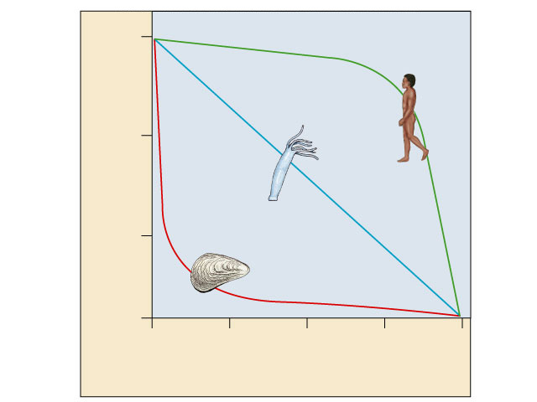
Survivorship curves
What do these graphs indicate regarding species survival rate & strategy?
1000
Human
(type I)
I. High death rate in post-reproductive years. – Humans – produce few offspring, but care for them
Hydra
(type II)
100
II. Constant mortality rate throughout life span. – some rodents & lizards, invertebrates
Survival per thousand
Oyster
(type III)
10
III. Very high early mortality but the few survivors then live long (stay reproductive) – marine invertebrates, fish – produce large #s of offspring, but do not care for them
1
0
25
50
75
100
Percent of maximum life span
Notes:
Type I curve is flat at the start, reflecting low death rates during early and middle life, then drops steeply as death rates increase among older age groups. Humans and many other large mammals that produce few offspring but provide them with good care often exhibit this kind of curve.
Type II curves are intermediate, with a constant death rate over the organism’s life span. This kind of survivorship occurs in Belding’s ground squirrels and some other rodents, various invertebrates, some lizards, and some annual plants.
Type III curve drops sharply at the start, reflecting very high death rates for the young, but then flattens out as death rates decline for those few individuals that have survived to a certain critical age. This type of curve is usually associated with organisms that produce very large numbers of offspring but provide little or no care, such as long–lived plants, many fishes, and marine invertebrates. An oyster, for example, may release millions of eggs, but most offspring die as larvae from predation or other causes. Those few that survive long enough to attach to a suitable substrate and begin growing a hard shell will probably survive for a relatively long time.

Slide 3
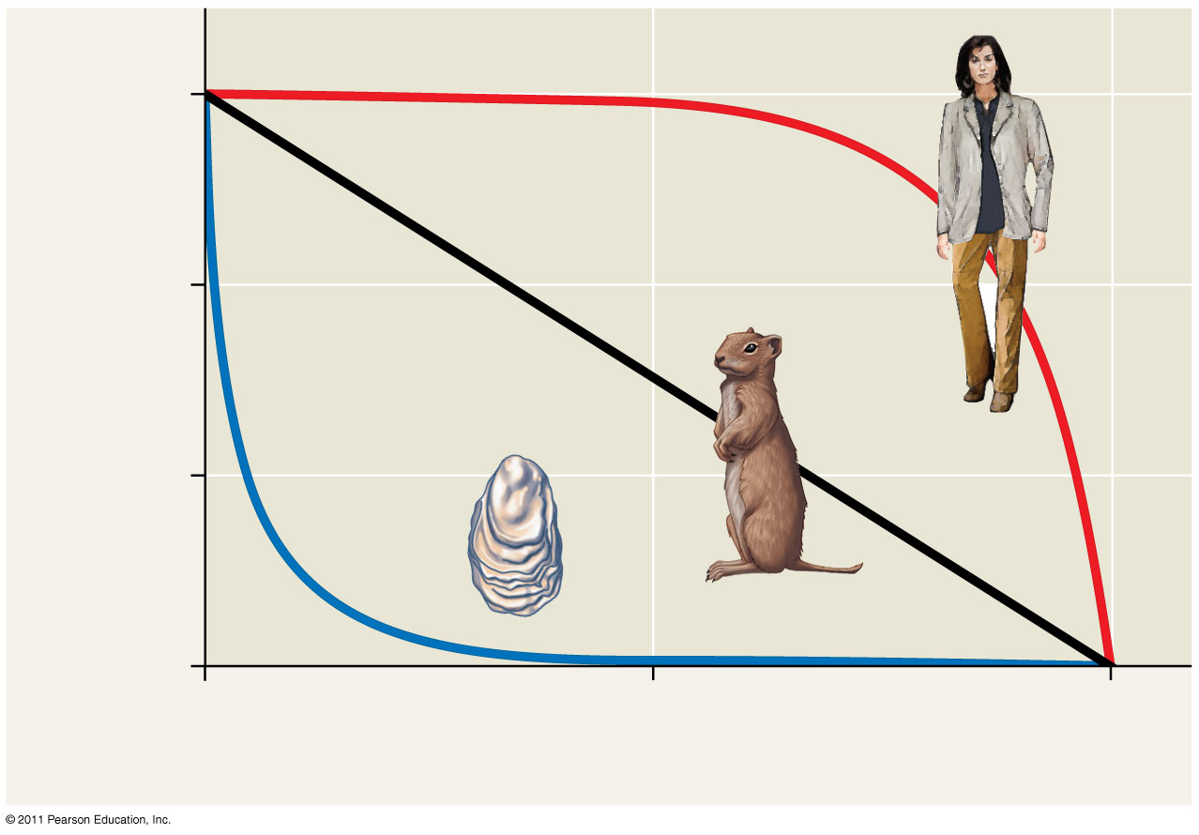
Ideal Survivorship Curves
1,000
I
100
II
Number of survivors (log scale)
10
III
1
0
50
100
Percentage of maximum life span
Notes:
3
Ask some graphical analysis questions:
Which type of curve would best depict the survivorship curve of jellyfish? Type III
Which type of curve would best depict the survivorship curve of a lizard? Type II

Slide 4
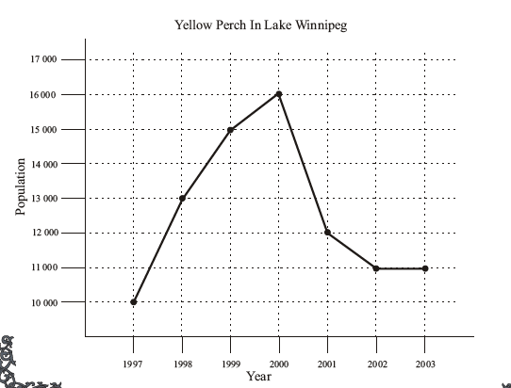
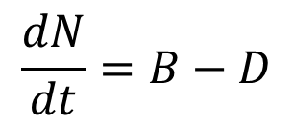
Population Growth Curves
d = delta or change
N = population Size
t = time
B = birth rate
D =death rate
Notes:
More graphical analysis questions: Ask students how many more deaths occurred in 2001 than births?
Qualitative Analysis: Locate both time intervals. In 2000, the population of perch was 16,000 in 2001, the population declined to 1600, therefore 4,000 more deaths occurred than there were births. Don’t let students think that it is as simple as 4,000 perch “died”, make sure they understand that births didn’t cease!
Quantitative Analysis: 𝑑𝑁/𝑑𝑡=𝐵−𝐷∴ =12,000−16,000=−4,000, therefore 4,000 more deaths than births between 2000 and 2001.

Slide 5
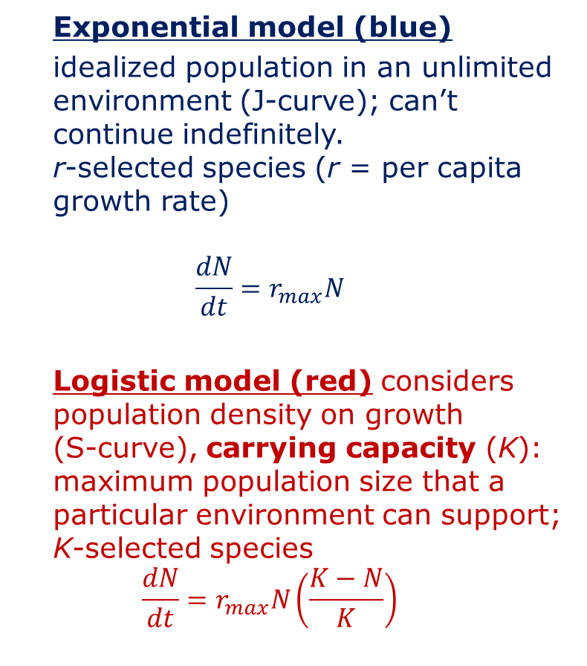
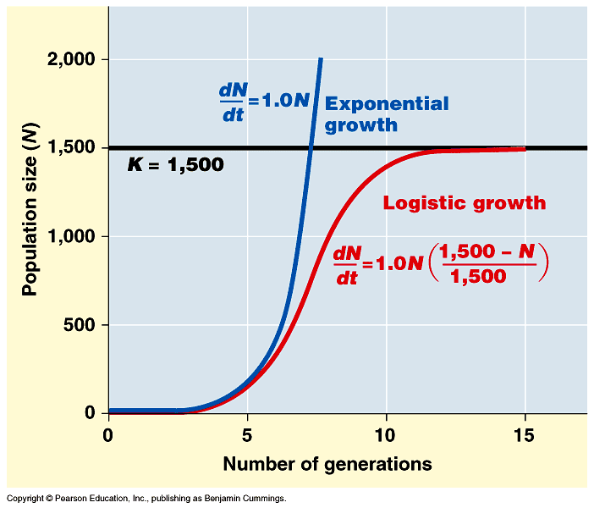
Population Growth Models
Notes:
WOW! 1 bacterium (reproducing every 20 minutes), could produce enough bacteria to form a layer over the entire surface of the Earth 1 foot deep!

Slide 6
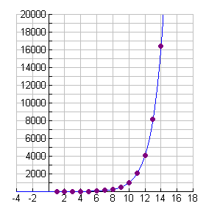
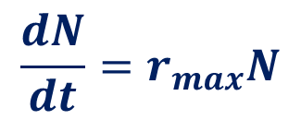
Exponential Growth Curves
Growth Rate of E. coli
d = delta or change
N = Population Size
t = time
r_{max} = maximum per
capita growth rate
of population
Population Size, N
Time (hours)
Notes:
One of the most common examples of exponential growth deals with bacteria. Bacteria can multiply at an alarming rate when each bacteria splits into two new cells, thus doubling. For example, if we start with only one bacteria which can double every hour since it reproduces asexually, by the end of one day we will have over 16 million bacteria.
http://www.regentsprep.org/Regents/math/ALGEBRA/AE7/ExpDecayL.htm

Slide 7
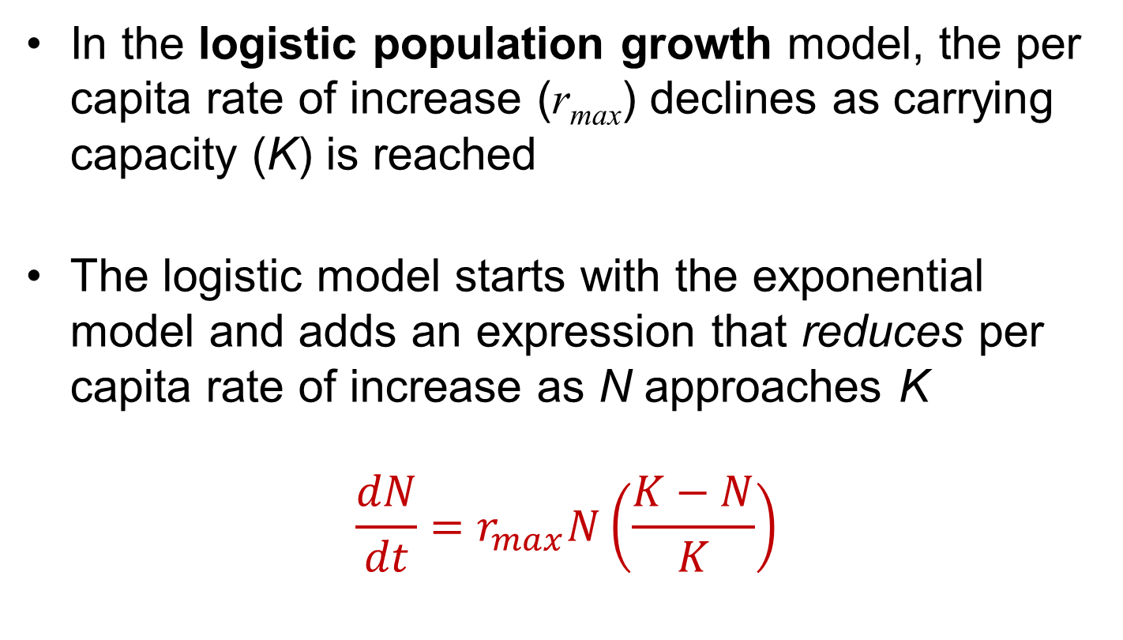
Logistic Growth Curves
Notes:
Keep emphasizing that “logistic” means as in “logarithm”.

Slide 8
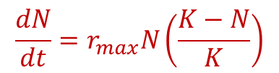
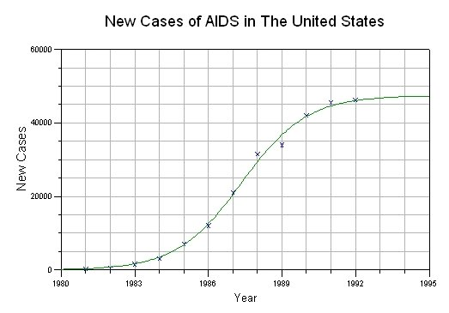
Logistic Growth Curves
d = delta or change
N = Population Size
t = time
K =carrying capacity
r_{max} = maximum per
capita growth rate
of population
Notes:
Ask: What is the carrying capacity (K ) for AIDS according to this graph? 45,000 as of 1995.

Slide 9
Comparison of Growth Curves
Notes:
Exponential population growth results in a J-shaped curve. The J-shaped curve of exponential growth characterizes some rebounding populations. For example, the elephant population in Kruger National Park, South Africa, grew exponentially after hunting was banned. The logistic model describes how a population grows more slowly as it nears its carrying capacity. Exponential growth cannot be sustained for long in any given population.
The logistic model of population growth produces a sigmoid (S-shaped) curve. A more realistic population model limits growth by incorporating carrying capacity. Carrying capacity (K) is the maximum population size the environment can support. Carrying capacity varies with the abundance of limiting resources. This figure shows population growth predicted by the logistic model. The growth of laboratory populations of paramecia fits an S-shaped curve. These organisms are grown in a constant environment lacking predators and competitors.

Slide 10
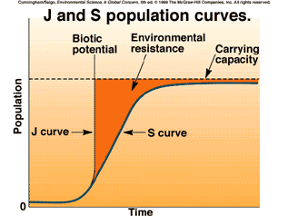
Growth Curve Relationship
Notes:
After the curve has leveled off, births and deaths are in balance and the population has zero population growth. This occurs because environmental limitations become increasingly effective in slowing population growth as the population density rises. When the density approaches the carrying capacity, the limitation becomes severe. A density dependent limitation, (K-N)/K, is one whose effect is determined by the density of the very population.

Slide 11
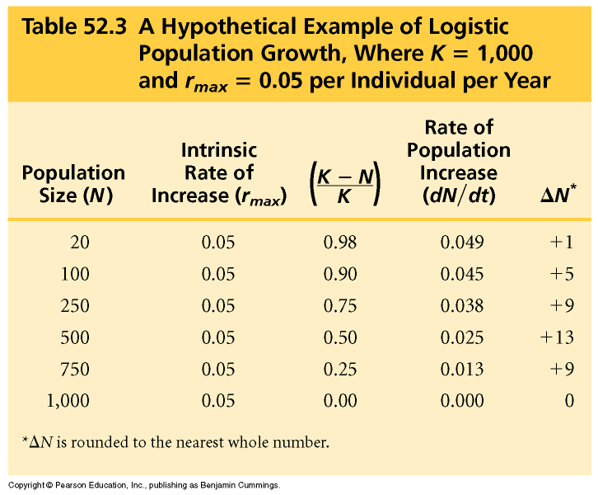
Examining Logistic Population Growth
Graph the data given as it relates to a logistic curve.
Title, label and scale your graph properly.
Notes:
Have students graph Number of Individuals or Population Size (N) vs. Time in Years and identify where and when the carrying capacity is reached for the hypothetical population.
Emphasize to students that the “versus” terminology is their friend since it is correctly states as “y vs. x” or “rise vs. run” if they are more comfortable with that terminology. They should know this from math class, but this protocol is not always followed among casually created materials.
So in this case, “Number of Individuals” (y-axis) vs. “Time (years)” are their y and x axes labels. Don’t move to the next slide until you’ve surveyed their graphs for the following: Proper title (Don’t let them get away with just restating the axes), proper labels on axes (units), proper scale, proper curve modeling as opposed to connecting data points “dot to dot” like they did in elementary school!
An example graph follows on the next slide (not in their handout).

Slide 12
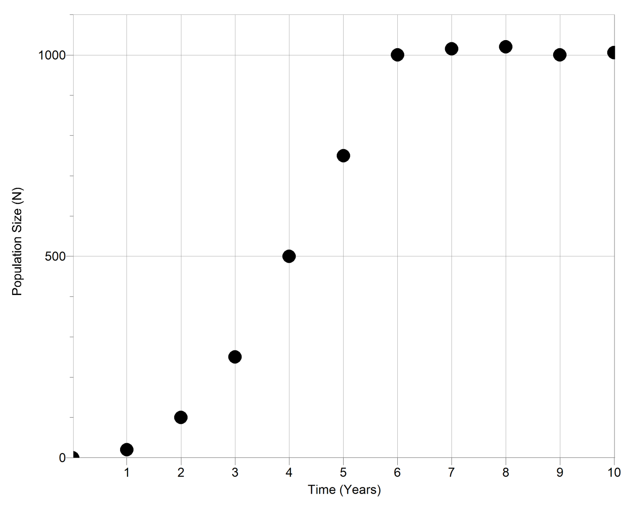
Examining Logistic Population Growth
Hypothetical Example of Logistic Growth Curve
K = 1,000 & r_{max} = 0.05 per Individual per Year
Notes:
The students do not have this slide. Give them an opportunity to correct any mistakes they made on their own graphs before leaving this slide.

Slide 13
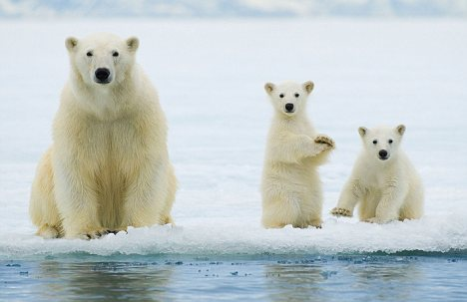
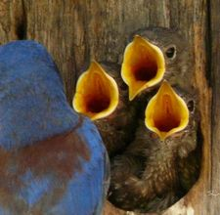

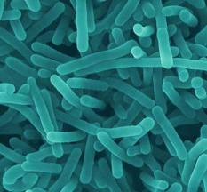

Population Reproductive Strategies
r-selected (opportunistic)
  Short maturation & lifespan
  Many (small) offspring; usually 1 (early) reproduction
  No parental care
  High death rate
K-selected (equilibrial)
  Long maturation & lifespan
  Few (large) offspring; usually several (late) reproductions
  Extensive parental care
  Low death rate
Notes:
Emphasize that these r-selected and opportunistic are synonyms as are K- selected and equilibrial. It’s the synonyms that will give students fits when they are reading and interpreting test questions!

Slide 14
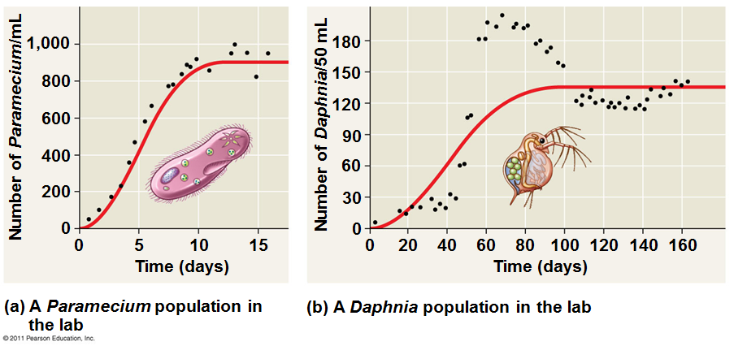
How Well Do These Organisms Fit the Logistic Growth Model?
Some populations overshoot K before settling down to a relatively stable density
Some populations fluctuate greatly and make it difficult to define K
Notes:
Have students examine the graph of Paramecium.
What is the carrying capacity of the population in the lab? About 900.
How long does it take the Paramecium to reach K? About 10 days.
Have students examine the graph of the Daphnia.
What is the carrying capacity of the population in the lab? About 90.
How long does it take the Paramecium to reach K? About 135 days.

Slide 15
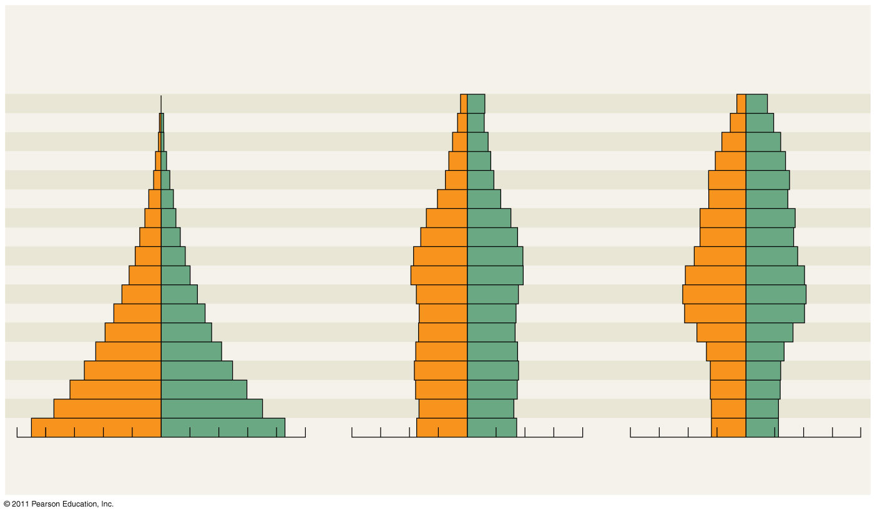
Age Structure Diagrams: Always Examine The Base Before Making Predictions About The Future Of The Population
Rapid growth
Afghanistan
Slow growth
United States
No growth
Italy
Male
Female
Age
85+
80–84
75–79
70–74
65–69
60–64
55–59
50–54
45–49
40–44
35–39
30–34
25–29
20–24
15–19
10–14
5–9
0–4
Male
Female
Age
85+
80–84
75–79
70–74
65–69
60–64
55–59
50–54
45–49
40–44
35–39
30–34
25–29
20–24
15–19
10–14
5–9
0–4
Male
Female
10
8
6
4
2
0
2
4
6
8
10
8
6
4
2
0
2
4
6
8
8
6
4
2
0
2
4
6
8
Percent of population
Percent of population
Percent of population
Notes:
15
Age-structure pyramids for the human population of three countries (data as of 2009). Emphasize to students that they should start their analysis at the BASE of these diagrams since that represents the most current population. Also emphasize they respect the vertical line on these diagrams that delineate male vs. female. Briefly explain why the predictions above each graph are likely to hold true.

