Slide 1
Descent with Modification: A Darwinian View of Life

Slide 2
Evolution
Evolution: the change over time of the genetic composition of populations
Natural selection: populations of organisms can change over the generations if individuals having certain heritable traits leave more offspring than others (differential reproductive success)
Evolutionary adaptations: a prevalence of inherited characteristics that enhance organisms’ survival and reproduction
November 24, 1859

Slide 3
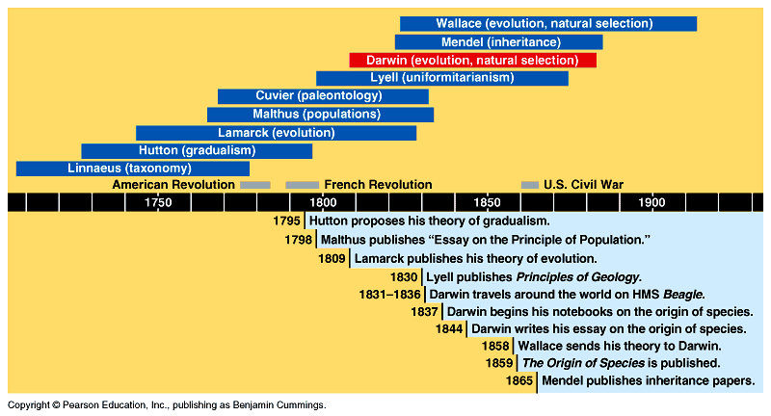
Evolutionary history
Linnaeus: taxonomy – grouping of organisms
Bionomial nomenclature – 2 word naming system
Cuvier: paleontology – study of fossils
Catastrophism – boundaries btw strata were caused by catastrophes that destroyed organisms – areas were repopulated by immigrating species

Slide 4
Evolutionary history
Hutton: gradualism – change takes place through slow, continuous processes – looked at geological features
Malthus: populations – much of human suffering was the consequence of human population increasing faster than food/resources

Slide 5
Evolutionary history
Lamarck: 1st theory of evolution
Suggested life evolves as environments change, but based theory on incorrect mechanism
Use/disuse – body parts used extensively become larger/stronger – if not used they deteriorate
Inheritance of acquired characteristics – organisms can pass these modifications to offspring

Slide 6
Evolutionary history
Lyell: uniformitarianism – same geological processes are at work today as in the past – modern geology
Darwin: evolution – 1831 voyage on HMSS Beagle – Natural/Artificial selection
Descent w/ Modifications
Wallace: came up with a theory of natural selection similar to Darwin – published first but gave credit to Darwin
Mendel: inheritance

Slide 7
Descent with Modification
5 observations:
1- Exponential fertility – populations would increase exponentially if all individuals born reproduced successfully
2- Stable population size
3- Limited resources
4- Individuals vary –
no 2 are exactly alike
5- Heritable variation

Slide 8
Descent with Modification
3 Inferences:
1- Struggle for existence – prod. of more offspring than the environment can support leads to a struggle for existence w/ only a fraction of offspring surviving
2- Non-random survival – ind. whose traits give them a greater probability of surviving/reproducing have a higher fitness & are likely to leave more offspring
3- Natural selection (differential success in reproduction) – unequal ability of ind. to survive/reproduce will lead to gradual change in pop.,w/ favorable characters accumulating over generations

Slide 9
Evolution evidence: Biogeography
Geographical distribution of species
Examples:
Islands vs. Mainland
Australia, Continents
Convergent evolution – similarities due to similar environment not common ancestor
Divergent evolution – similar organisms adapt differently due to environments

Slide 10
Evolution evidence: The Fossil Record
Succession of forms over time
Transitional links – evidence of descent w/ modifications
Vertebrate descent
Ex. Fossilized leg bones of ancient whales

Slide 11
Evolution evidence: Comparative Anatomy
Homologous structures
(homology) – similar
structure w/ different
functions
Ex: forelimbs of human,
whale, bat
Similarities result from descent from a common
ancestor
Vestigial organs – remnants of structures that once served a purpose
Ex: whale/snake pelvic girdles; wings on flightless birds

Slide 12
Evolution evidence: Comparative Embryology
Pharyngeal pouches = gills, ears/throat
‘tails’ as embryos
Develop into homologous structures w/ very different functions

Slide 13
Evolution evidence: Molecular Biology
Similarities in DNA, proteins, genes, and gene products
Common genetic code
Also use RNA

