Slide 1
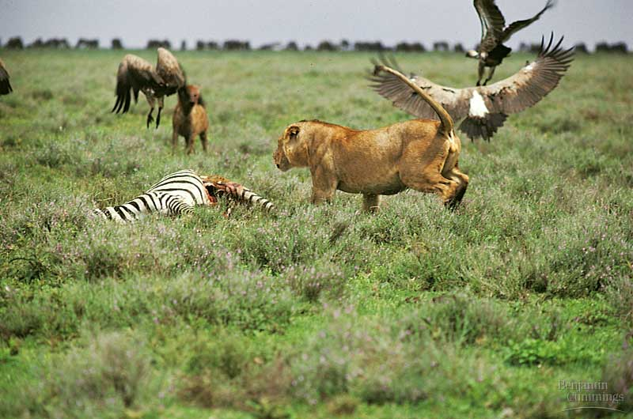
Ecology
Communities:
Populations are linked by interspecific interactions that impact the survival & reproduction
of the species involved

Slide 2
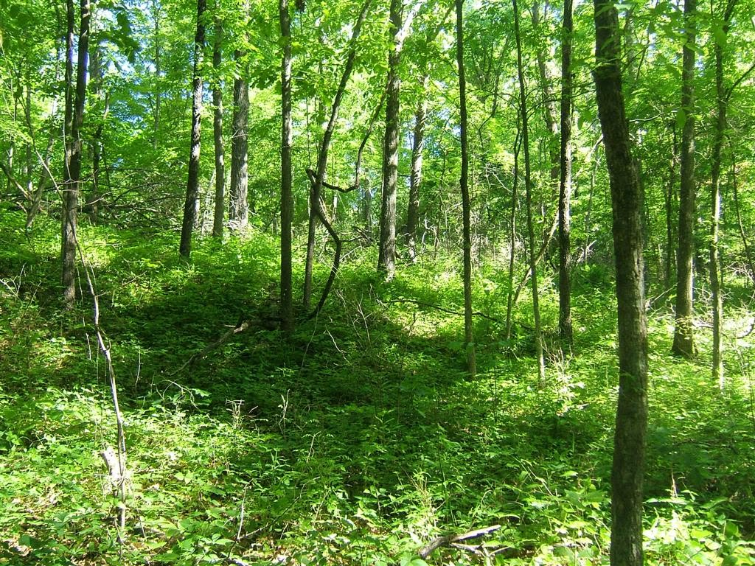
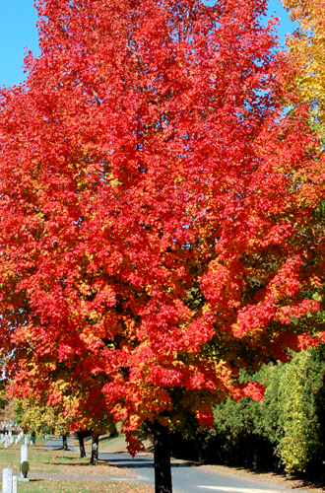
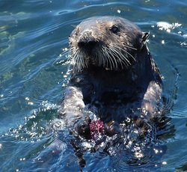
Community Structure
Community−an assemblage of populations living close enough together for potential interaction
Dominant Species−most abundant, highest biomass, powerful control over occurrence and distribution of other species… VA Sugar Maple
Keystone Species−NOT necessarily most abundant, exert strong control due to their ecological roles or niches… Sea Otters!!!
Richness number of species & abundance
Species diversity: older = greater diversity; larger areas = greater diversity; climate = solar input & H₂O available
Notes:
2

Slide 3
Biodiversity
Communities with higher diversity are
More productive and more stable regarding their productivity
Better able to withstand and recover from environmental stresses
More resistant to invasive species, organisms that become established outside their native range
3
Notes:
3

Slide 4
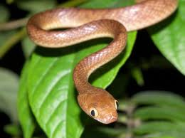
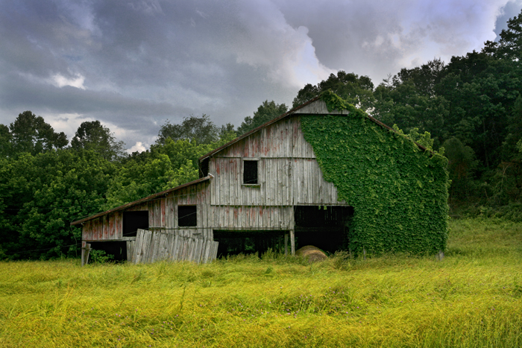
Invasive/Introduced Species
What’s the big deal?
These species are free from predators, parasites and pathogens that limit their populations in their native habitats.
These transplanted species disrupt their new community by preying on native organisms or outcompeting them for resources.

Slide 5
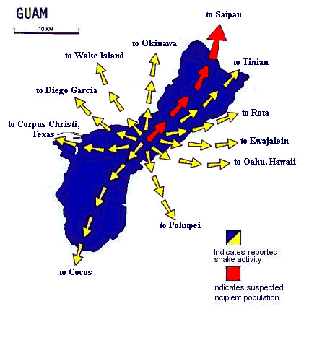
Guam: Brown Tree Snake
The brown tree snake was accidentally introduced to Guam as a stowaway in military cargo from other parts of the South Pacific after World War II.
Since then, 12 species of birds and 6 species of lizards the snakes ate have become extinct.
Guam had no native snakes.
Dispersal of Brown Tree Snake

Slide 6
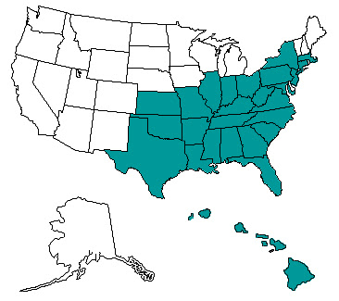
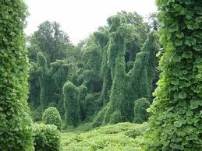
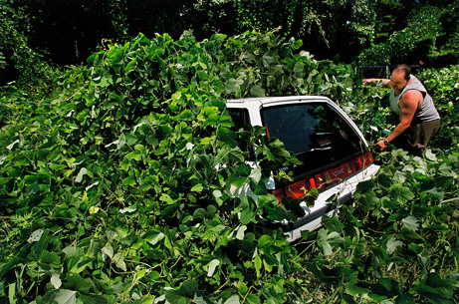
Southern U.S.: Kudzu Vine
The Asian plant Kudzu was introduced by the U.S. Dept. of Agriculture with good intentions.
It was introduced from Japanese pavilion in the 1876 Centennial Exposition in Philadelphia.
It was to help control erosion but has taken over large areas of the landscape in the Southern U.S.

Slide 7
New York: European Starling
From the New York Times, 1990
The year was 1890 when an eccentric drug manufacturer named Eugene Schieffelin entered New York City's Central Park and released some 60 European starlings he had imported from England. In 1891 he loosed 40 more. Schieffelin's motives were as romantic as they were ill fated: he hoped to introduce into North America every bird mentioned by Shakespeare.
Skylarks and song thrushes failed to thrive, but the enormity of his success with starlings continues to haunt us. This centennial year is worth observing as an object lesson in how even noble intentions can lead to disaster when humanity meddles with nature.

Slide 8
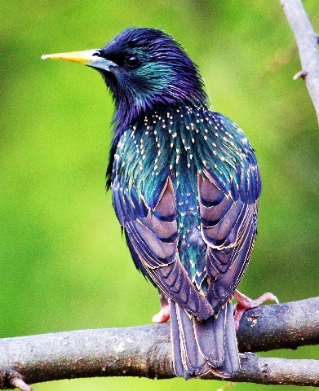
New York: European Starling
From the New York Times, 1990 (cont.)
Today the starling is ubiquitous, with its purple and green iridescent plumage and its rasping, insistent call. It has distinguished itself as one of the costliest and most noxious birds on our continent.
Roosting in hordes of up to a million, starlings can devour vast stores of seed and fruit, offsetting whatever benefit they confer by eating insects. In a single day, a cloud of omnivorous starlings can gobble up 20 tons of potatoes.

Slide 9
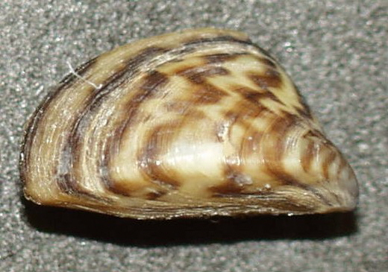
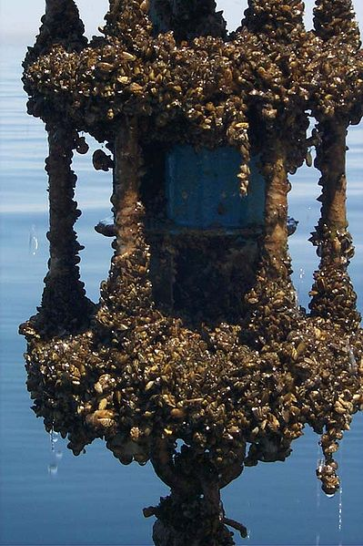
Zebra Mussels
The native distribution of the species is in the Black Sea and Caspian Sea in Eurasia.
Zebra mussels have become an invasive species in North America, Great Britain, Ireland, Italy, Spain, and Sweden.
They disrupt the ecosystems by monotypic (one type) colonization, and damage harbors and waterways, ships and boats, and water treatment and power plants.

Slide 10
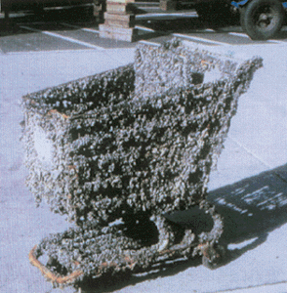
Zebra Mussels
Water treatment plants are most impacted because the water intakes bring the microscopic free-swimming larvae directly into the facilities.
The Zebra Mussels also cling on to pipes under the water and clog them.
This shopping cart was left in zebra mussel-infested waters for a few months. The mussels have colonized every available surface on the cart.
(J. Lubner, Wisconsin Sea Grant, Milwaukee, Wisconsin.)

Slide 11
Measurement of Biodiversity
Species Richness
(# of different species)
Species Diversity = + Relative abundance
(proportion each different species represents of all the individuals in the community)
11
Notes:
11

Slide 12
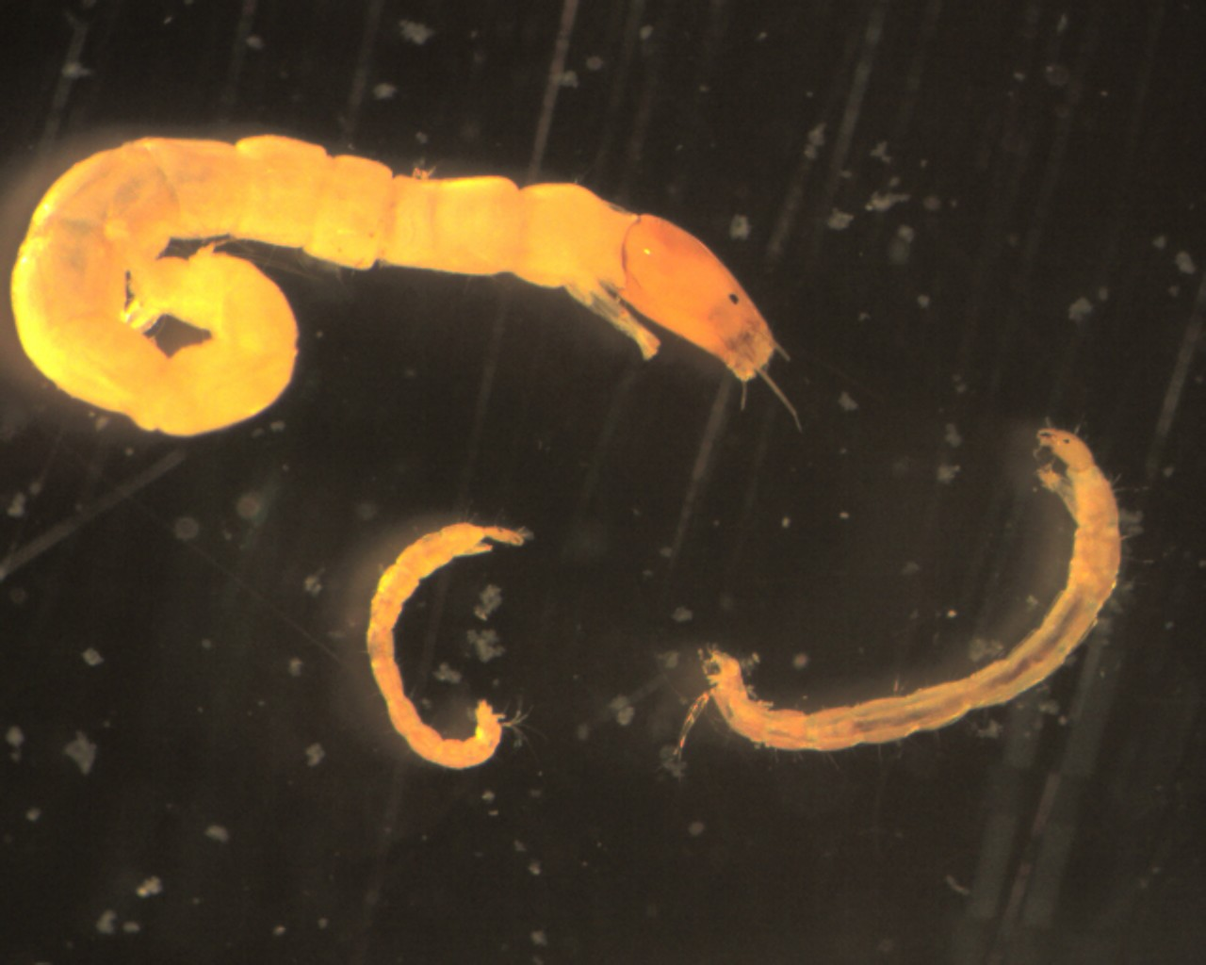
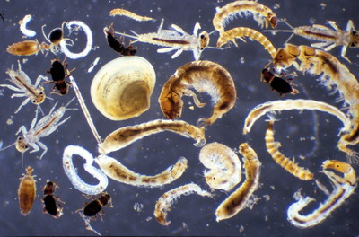
Species Richness
A
Which community is richer?
B
12
Notes:
12

Slide 13
Sample Data
The data below represents the abundance of macro-invertebrates taken from three different river communities in Georgia. A variety of diversity indices may be used to calculate species diversity. Based on the data below, which community has the greatest diversity?
13
Notes:
13

Slide 14
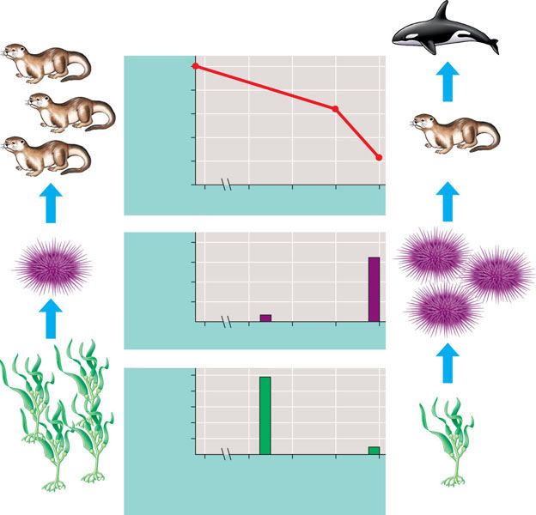
Observation Of Sea Otter Populations And Their Predation
100
80
60
Otter number (% max. count)
40
20
0
(a) Sea otter abundance
400
300
Grams per 0.25 m²
200
100
0
(b) Sea urchin biomass
10
8
6
Number per 0.25 m²
4
2
0
1972
1985
1989
1993
1997
Year
Food chain before killer whale involve- ment in chain
(c) Total kelp density
Food chain after killer whales started preying on otters
Notes:
14

Slide 15
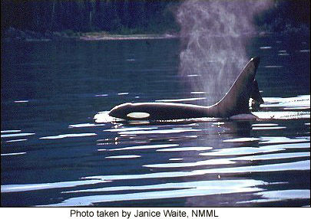
Killer Whales vs. Sea Otters Energetics
The daily caloric requirements for male versus female killer whales (orcas) is shown below:
Male killer whale: 308,000 kcal/day
Female killer whale: 187,000 kcal/day
Calculate the average caloric value of a sea otter assuming a male orca consumes five sea otters each day to meet its caloric requirement.

Slide 16
Killer Whales vs. Sea Otters
Calculate the average caloric value of a sea otter assuming a male orca consumes five sea otters each day to meet its caloric requirement.
Using dimensional analysis or simple arithmetic:
Notes:
16

Slide 17
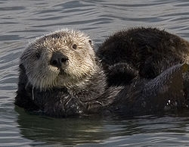
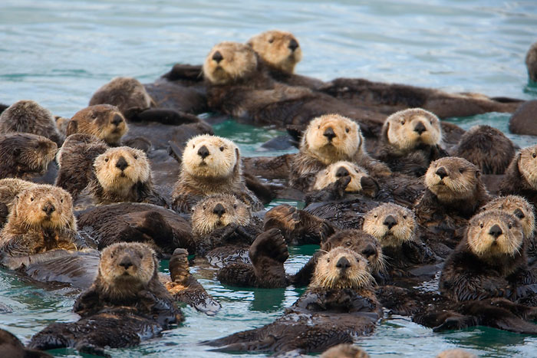
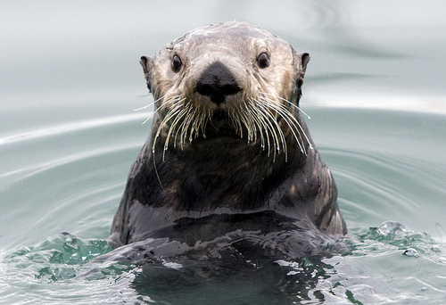
Killer Whales vs. Sea Otters
Predator-Pray Energetics
Assume a population of 4 male orcas feed solely on sea otters. How many otters are lost to the community over a 6-year period?

Slide 18
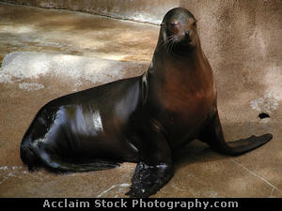
Interestingly, The Sea Otter Is Not Usually The Orca’s Food of Choice
Why the change?
Some fish populations have declined in recent decades
Shortage of certain fish caused substantial declines in harbor seals and sea lions
Shortage of seals and sea lions resulted in killer whales preying on smaller sea otters
Notes:
18

Slide 19
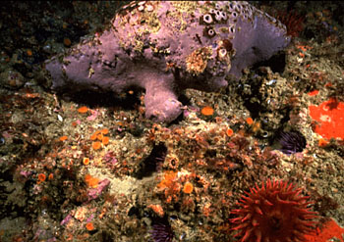
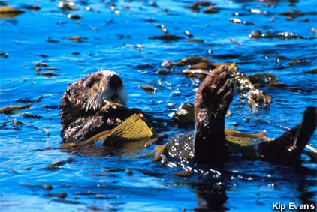
Why Should We Care About Declining Numbers of Sea Otters?
Sea otters are an important part of the coastal community.
The loss of sea otters affects the community directly and indirectly.
Notes:
19

Slide 20
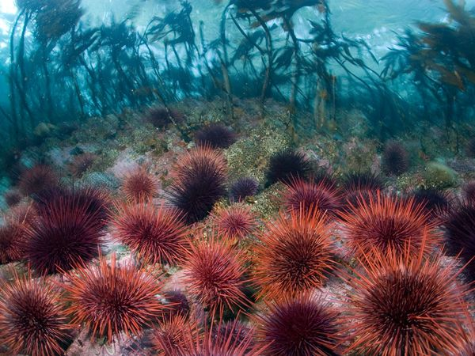
Indirect Effect on the Community
A keystone species is one that has a strong effect on the composition of the community
Removal of keystone species causes a decrease in species richness
Sea otters eat sea urchins which are fierce competitors having a diet of kelp
Notes:
20

Slide 21
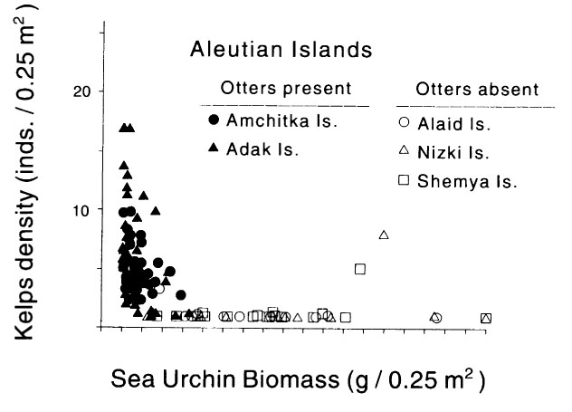
Sea Urchin Population vs. Kelp Density
21
Notes:
21

Slide 22
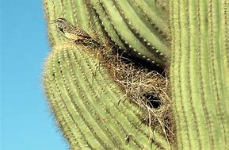
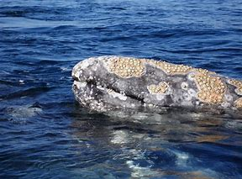
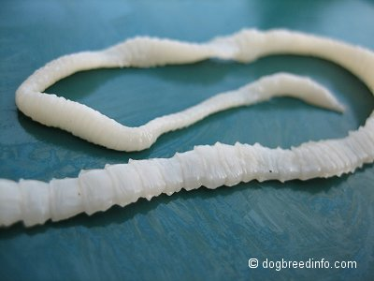
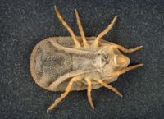
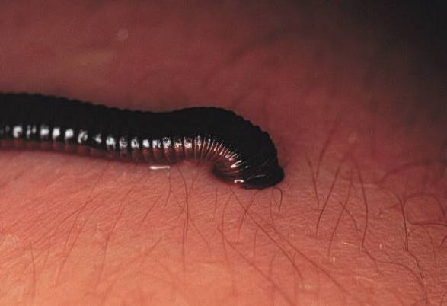
Factors that Impact Communities
1. Disease
2. Interspecific Interactions:
Competition
Predation
Symbiosis
Mutualism − ex. mycorrhizae
Commensalism
Parastism
Notes:
22

Slide 23
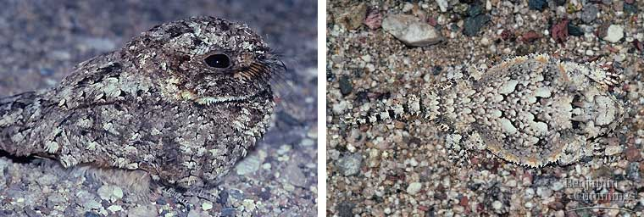
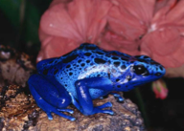
Defense Mechanisms
Mullerian-Two or more unpalatable, aposematically colored species resemble each other
Batesian-palatable/ harmless species mimics an unpalatable/ harmful model
Cryptic-camouflage
Aposematic-warning
Notes:
23

Slide 24
Ecological Niches
An organism’s niche is the specific role it plays in its environment…its job!
All of its uses of biotic and abiotic resources in its environment
Ex: oak tree in a deciduous forest
Provides oxygen to plants, animals
Provides a home for squirrels
Provides a nesting ground for blue jays
Removes water from the soil
Notes:
24

Slide 25
The Niche
Ecological niche is the total of an organism’s use of biotic and abiotic resources in its environment
Ex: Barnacle species on the coast of Scotland
Notes:
25

Slide 26
Succession
Ecological succession− transition in species composition over ecological time
Pioneer organisms = bacteria, lichen, algae
Climax community = stable
Primary− begun in lifeless area; no soil, perhaps volcanic activity or retreating glacier.
Secondary – an existing community has been cleared by some disturbance that leaves the soil intact
Notes:
26

Slide 27
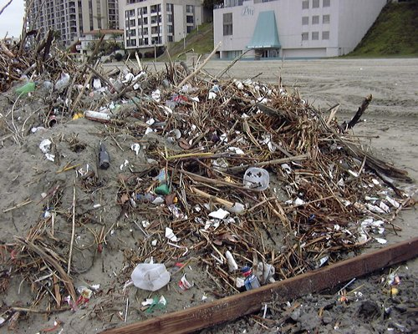
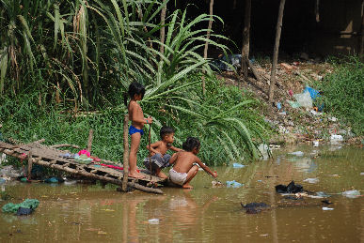
Human Impact on Ecosystems
Humans are the most widespread agents of disturbance
Reduces diversity
Prevent some naturally occurring disturbances
Notes:
27

Slide 28
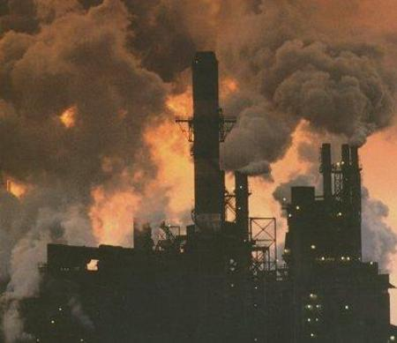
Human Impact on Ecosystems
Combustion of Fossil Fuels
Leads to acid precipitation
Changes the pH of aquatic ecosystems and affects the soil chemistry of terrestrial ecosystems
Notes:
28

Slide 29
Biomes
often named for predominant plant life and blend into each other without sharp boundaries - determined by temperature/precipitation

Slide 30
Terrestrial Biomes
30
Notes:
30

Slide 31
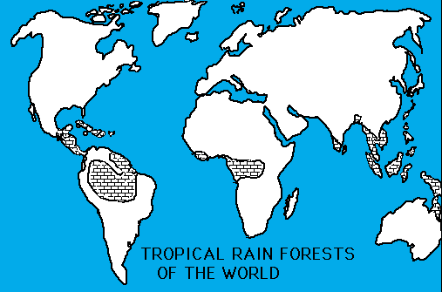
Tropical Rain Forest
Hot/wet (humid) year round – near equator
Average temps
20-34C/68-93F
Rains daily
Most diverse
Soil poor in nutrients
Plant-life – canopy, ferns
Sloths, jaguars, monkeys, parrots, piranhas, reptiles, insects
31
Notes:
31

Slide 32
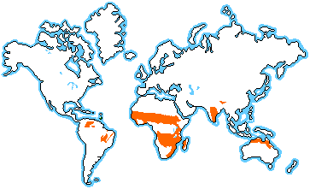
Savanna
Always warm – seasonal rainfall (6 months) - east Africa
Average temps
16-34C/61-93F
Acaia trees – porous soil
Migratory animals, Lions, cheetahs, hyena, rhino, zebra, ostrich
32
Notes:
32

Slide 33
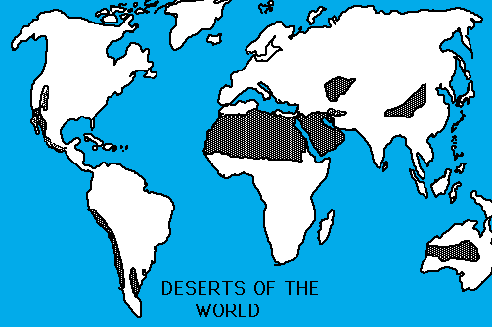
Desert
Very little rain
Severe temp. changes - hot days and cold nights
Average temp
7-38C/45-100F
Arizona, north Africa
Cacti
Many nocturnal animals, Mountain lions, antelope, hawks, snakes, lizards, roadrunners, small rodents
33
Notes:
33

Slide 34
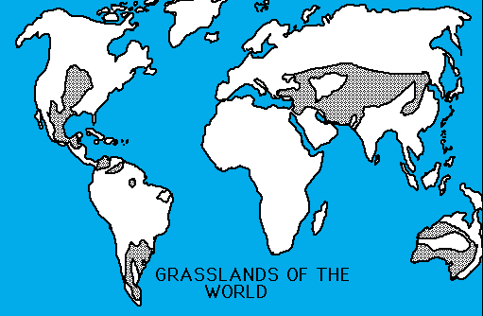
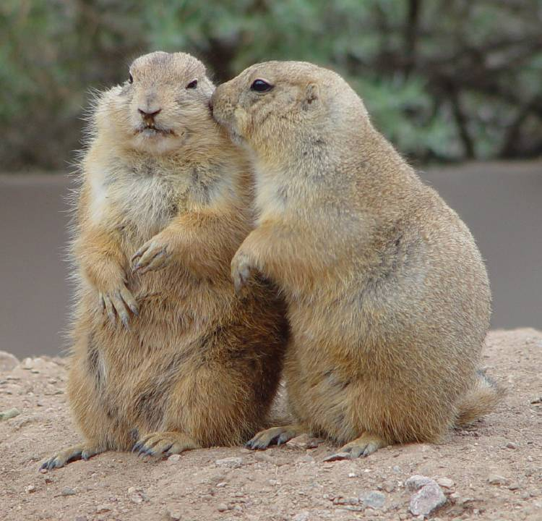
Temperate Grasslands
Warm to hot summer/cold winter - central U.S.
Average temp
0-25C/32-77F
Farming, grasses
Prairie dogs, buffalo, armadillo, coyotes
34
Notes:
34

Slide 35
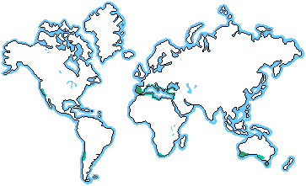
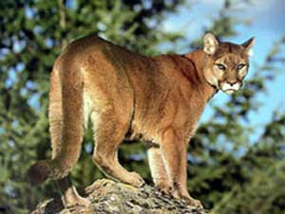
Chaparral- also called Scrubland
Hot, dry summers /cool, moist winters
Along coasts
Average temp
10-18C/50-65F
Scrub oaks – soil low in nutrients
Black-tailed deer, bobcats, mountain lions
Western movies
Periodic fires
35
Notes:
35

Slide 36
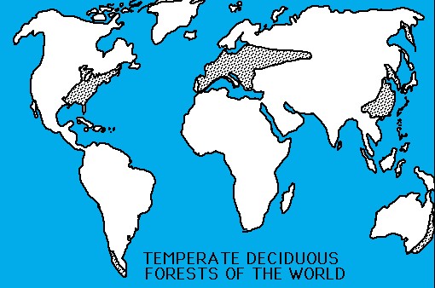
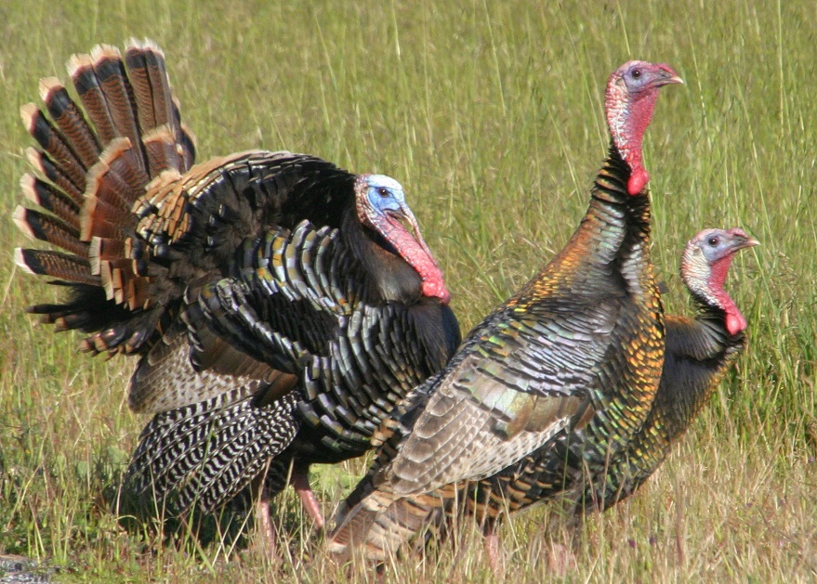
Temperate Forest
Warm summers/cold winters – see 4 seasons
Eastern U.S.
Even rainfall
Average temp 6-28C/43-82F
Deciduous trees – oaks
Good topsoil
White-tailed deer, bobcats, turkey, black bears, raccoons
36
Notes:
36

Slide 37
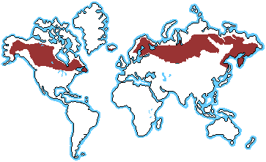
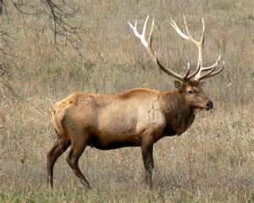
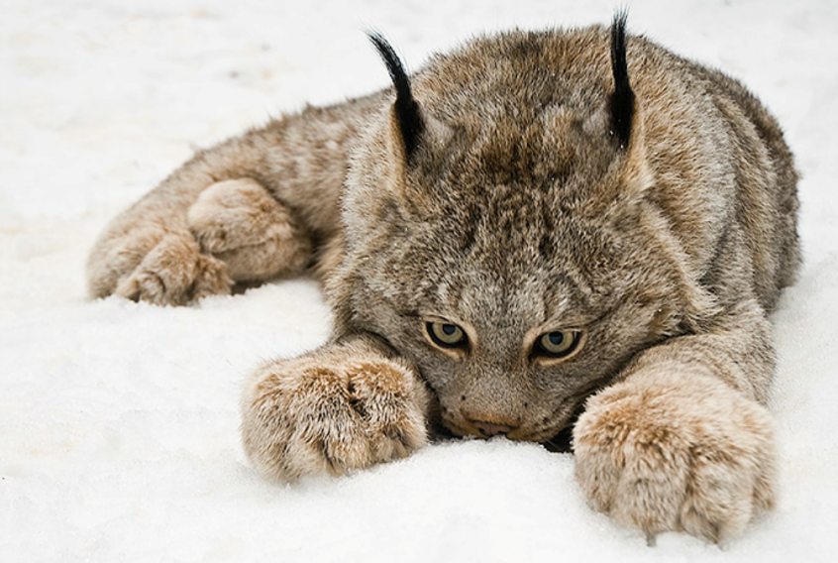
Taiga
Also called Coniferous or
Boreal Forest
Long, cold winters/short mild summers – Alaska
Average temp
-10-14C/14-57F
Evergreen trees – conifers
Acidic soil
Wolves, moose/elk, lynx
37
Notes:
37

Slide 38
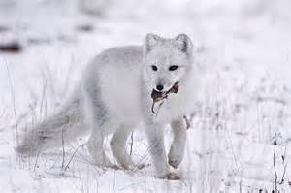
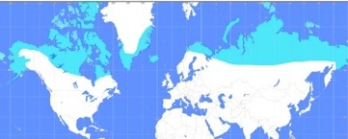
Tundra
Freezing winters/very short summers
Long periods of darkness
Average temp
-26-12C/-15-53F
Permafrost (ground is permanently frozen) – northern Alaska and Canada
Very little precipitation
Lichens
Caribou, Lemmings, Arctic Foxes
38
Notes:
38

Slide 39
Aquatic Biome Distribution
39

Slide 40
Biosphere – all the biomes combined
40
Notes:
40

