Slide 1
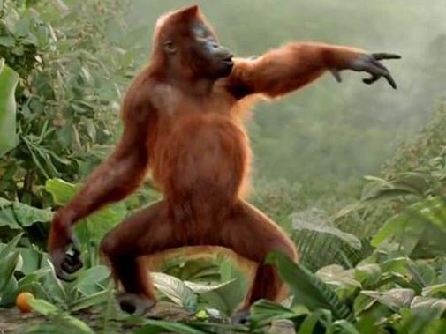
Ecology
Animal Behavior

Slide 2
Nature vs. Nurture?
Genes and the environment both influence behavior
Innate behavior is developmentally fixed, regardless of the environment, and under strong genetic influence (ex. agonistic behavior)
Learned behavior is due to cognitive development, change with experience & environment (ex. Mother bears teach their cubs about hunting, berry picking, fishing, and the best places to find tasty grubs)

Slide 3
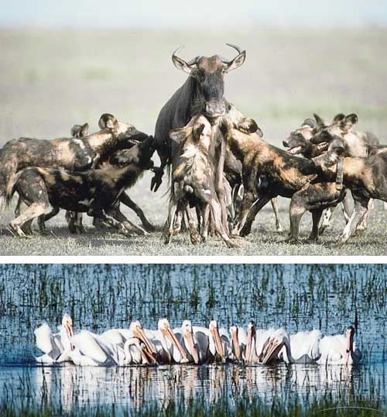
Competitive Social Behaviors Often Represent Contests for Resources
Cooperative behavior is when an animal invests resources in a common interest shared by other group members
Copyright © 2002 Pearson Education, Inc., publishing as Benjamin Cummings

Slide 4
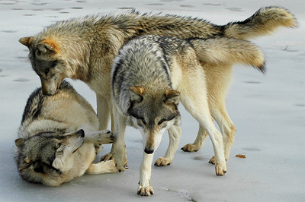
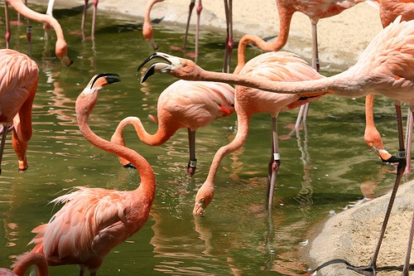
Competitive Social Behaviors Often Represent Contests for Resources
Agonistic behavior is any social behavior that involves fighting, thus it is a contest involving threats.
Made of a suite of three different divisions of behaviors: threats, aggression, and submission.
Generally, no harm is done.

Slide 5
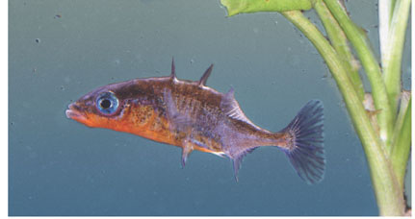
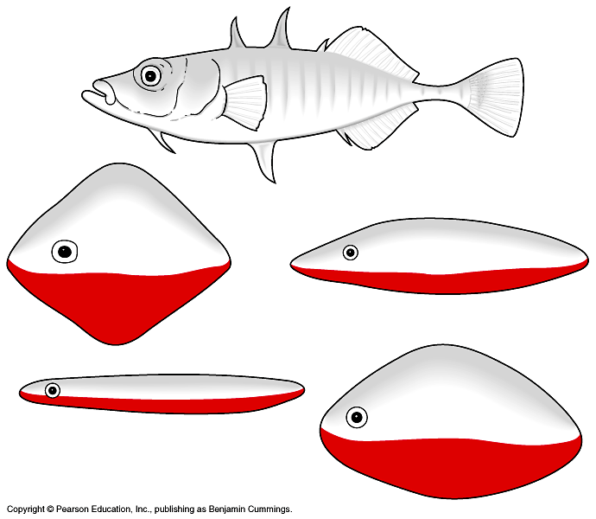
Fixed Action Patterns (FAP)
A sequence of unlearned (innate) , unchangeable behavioral acts, that once started, are carried out to completion
Triggered by a sign stimulus (external sensory stimulus)
Ex: Agonistic (aggressive) behavior in 3-spined stickleback male fish in response to the red underside of an intruder fish

Slide 6
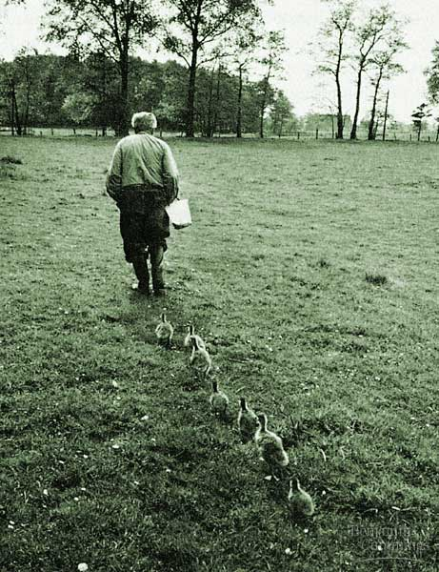
Imprinting
A type of behavior that includes both learning and innate components and is irreversible.
Limited phase (critical period) early in an animal’s development, is the only time certain behaviors can be learned.
Incubator-hatched goslings imprinted on scientist (Konrad Lorenz) during first few hours of life and followed him

Slide 7
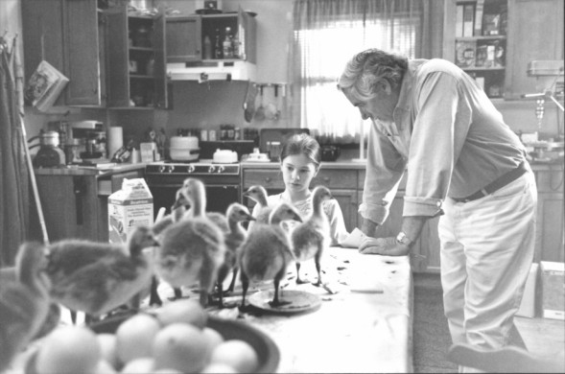
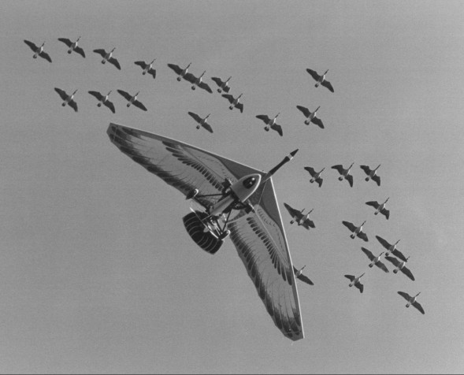
Movie “Fly Away Home”
The movie involves Canadian Geese, but the concept is based on an organization named Operation Migration which has played a leading role in the reintroduction of endangered Whooping cranes into eastern North America since 2001. In the 1940s the species was reduced to just 15 birds.

Slide 8
Directed Movements
Controlled by genes
Kinesis = change in activity rate in response to stimuli. Ex. Isopods live best in moist conditions; move more in dry areas to increases likelihood of encountering a moist area
Taxis = a more or less automatic, oriented movement toward or away from a stimulus
Migration - using sun (seasonal changes), stars, Earth’s magnetic field

Slide 9
Animal Signals & Communication
Signal - behavior that causes change in another’s behavior
Communication involves the transmission of, reception of, and response to signals between animals.
Animal communication is any behavior on the part of one animal that has an effect on the current or future behavior of another animal.

Slide 10
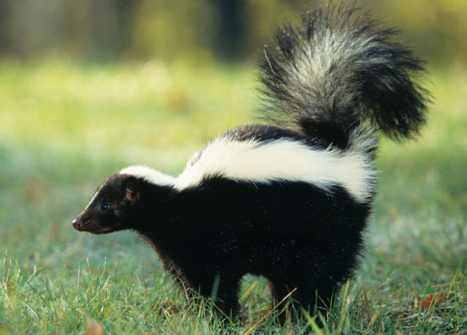
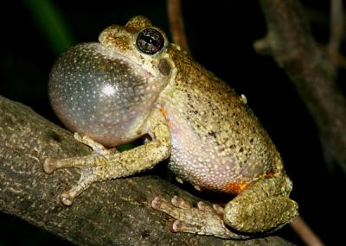
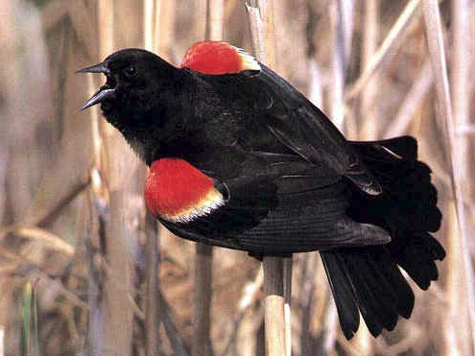
Animal Signals & Communication
Chemical Communication:
Pheromones – important in reproduction behavior
Scents—important in marking territory or defense
Auditory Communication (vocalization):
Drosophila males produce a characteristic “song” by beating their wings, insects (innate, genetic)
Mating songs in birds (innate & learned)

Slide 11
Environment & Genetics
Environmental factors, such as the quality of the diet, the nature of social interactions, and opportunities for learning can influence the development of behaviors in every group of animals
Example: Variations in diet led to rejection of mates in Drosophila

Slide 12
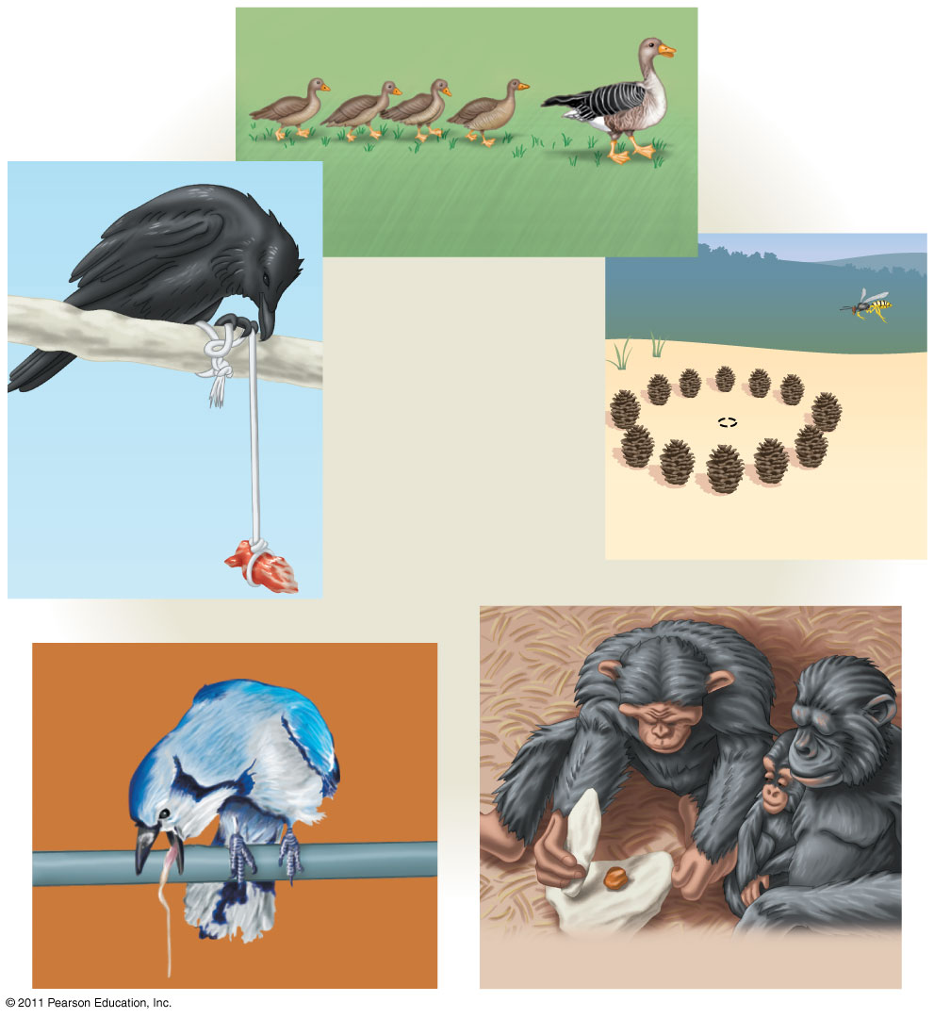
Imprinting
Learning and problem solving
Spatial learning
Cognition
Associative learning
Social learning

Slide 13
Learning
Learning – the modification of behavior based on specific experiences
Maturation: behavior due to developing physiological changes
Habituation: loss of responsiveness to stimuli that convey little or no information
Spatial Learning: the modification of behavior based on experience with the spatial structure of the environment, including the location of nest sites, hazards, food, and prospective mates
Associative Learning- behavior through trial and error

Slide 14
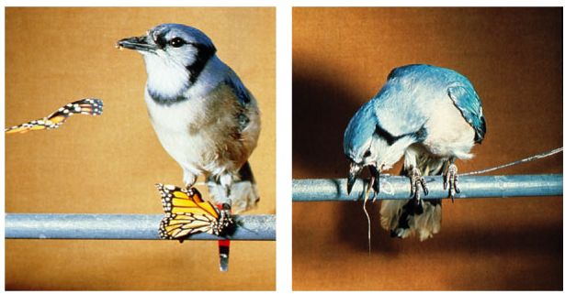
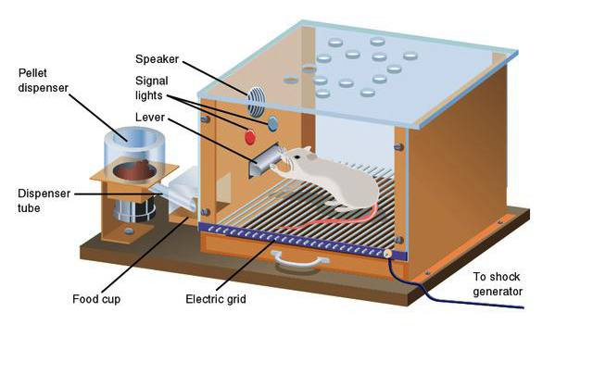
Associative Learning
The ability of many animals to associate one feature of the environment with another
Classical Conditioning
arbitrary stimulus associated with reward
or punishment
Pavlov’s Experiment
Operant Conditioning
“trial-and-error learning”
Associates behavior with reward or
punishment – Skinner Box
Notes:
Bird Flocking
Simulator: http://www.lalena.com/ai/flock/
Dolphins & Bats Biosonar
http://www.biosonar.bris.ac.uk/contentss.htm
EvoTutor
http://www.evotutor.org/index.html
Pavlov
http://www.brainviews.com/abFiles/AniPavlov.htm

Slide 15
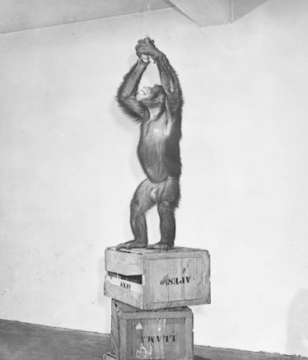
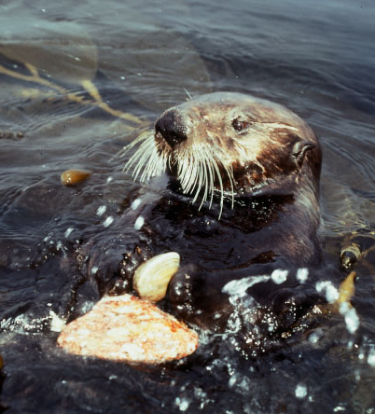
Cognition & Problem Solving
The ability of an animal’s nervous system to perceive, store, process, and use info gathered by sensory receptors
Ex: monkey stacking boxes in order to reach bananas or the use of tools

Slide 16
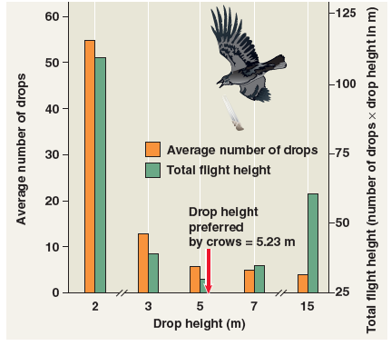
Interpret This Data

Slide 17
Crow & Whelk Data
N_{avg} Drops Required
to Break Shell
(Drop Height × N_{avg} Drops) = “Cost−Benefit Analysis”
Drop Height (m)
2 55 110
3 13 39
5 6 30
7 5 35
15 4 60
Copyright © 2002 Pearson Education, Inc., publishing as Benjamin Cummings

Slide 18
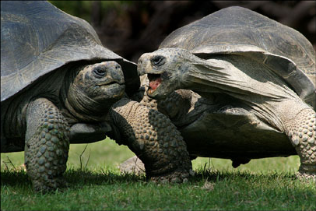
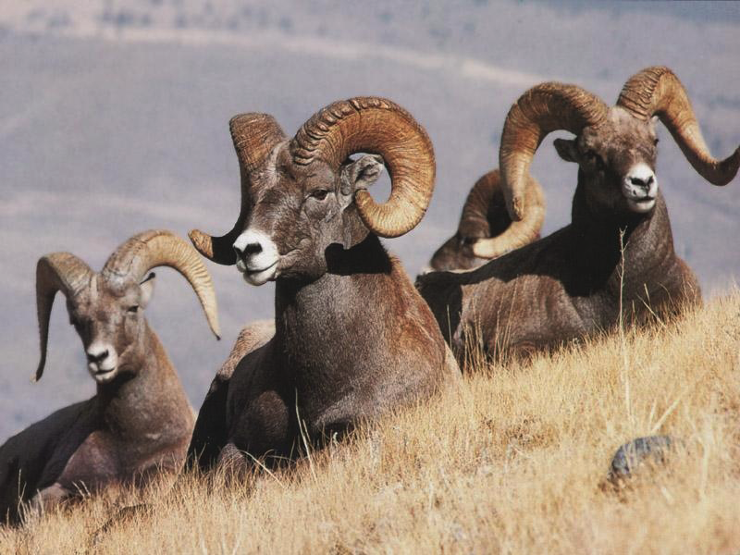
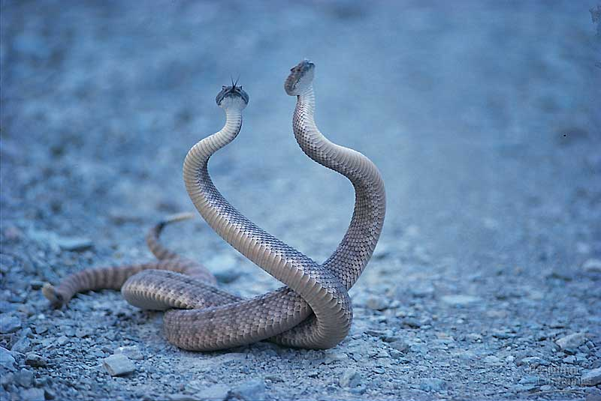
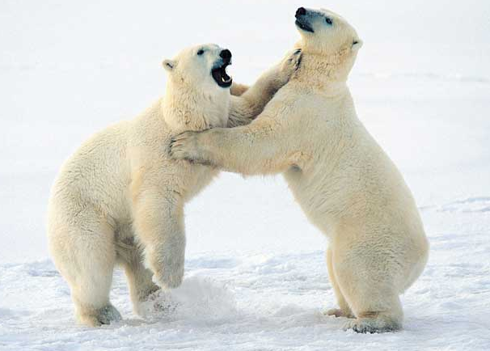
Social Behavior
Agonistic behavior – contest behavior determining access to resources
Dominance hierarchy - pecking order
Territoriality - defending an area against others
Notes:
LO 2.21 The student is able to justify the selection of the kind of data needed to answer scientific questions about the relevant mechanism that organisms use to respond to changes in their external environment.
Include a connection between the slide and this LO – such as what kinds of data would one use to answer questions related to these behaviors?

Slide 19
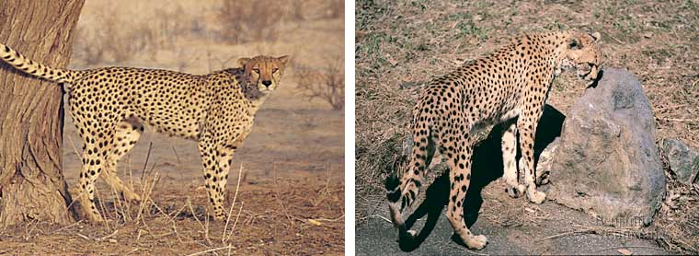
Territoriality
Territorial animals defend areas that contain a nest, den or mating site, and sufficient food resources for themselves and their young.
Spraying behavior is a way for an individual to mark its territory.
Downside - Territoriality uses a great deal of an individual’s energy. In addition, an individual might die defending a territory, thus miss a reproductive opportunity
Fig. 51.22
Copyright © 2002 Pearson Education, Inc., publishing as Benjamin Cummings

Slide 20
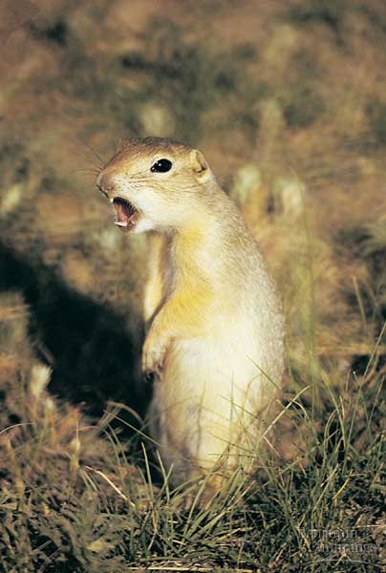
The Concept Of Inclusive Fitness Can Account For Most Altruistic Behavior
Most social behaviors are selfish, so how do we account for behaviors that help others?
Altruism is defined as behavior that might decrease individual fitness, but increase the fitness of others.

Slide 21
Altruism
Altruistic behavior is common throughout the animal kingdom, particularly in species with complex social structures.
In social insect colonies (ants, wasps, bees, and termites), sterile workers devote their whole lives to caring for the queen, constructing and protecting the nest, foraging for food, and tending the larvae.

Slide 22
Identify the Behavior
What type of behavior is involved when an animal is exposed to a new situation without any prior relevant experience and performs a behavior that generates a desired outcome?

Slide 23
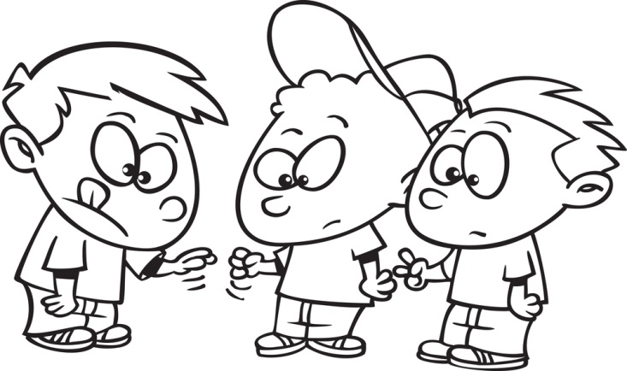
Identify the Behavior
What type of behavior is involved when one child teaches others a new game?

Slide 24
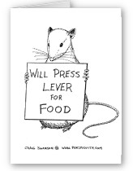
Identify the Behavior
What type of behavior is involved when a rat pushes a lever to obtain food?

Slide 25
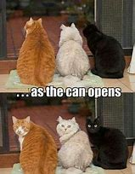
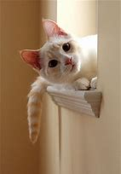
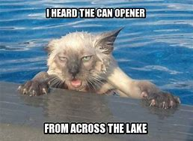
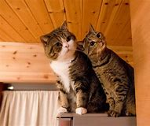
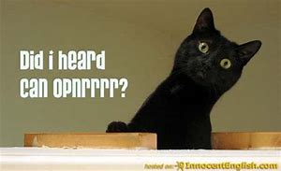
Identify the Behavior
What type of behavior is involved when a cat responds to a canopener?

